Slide 1
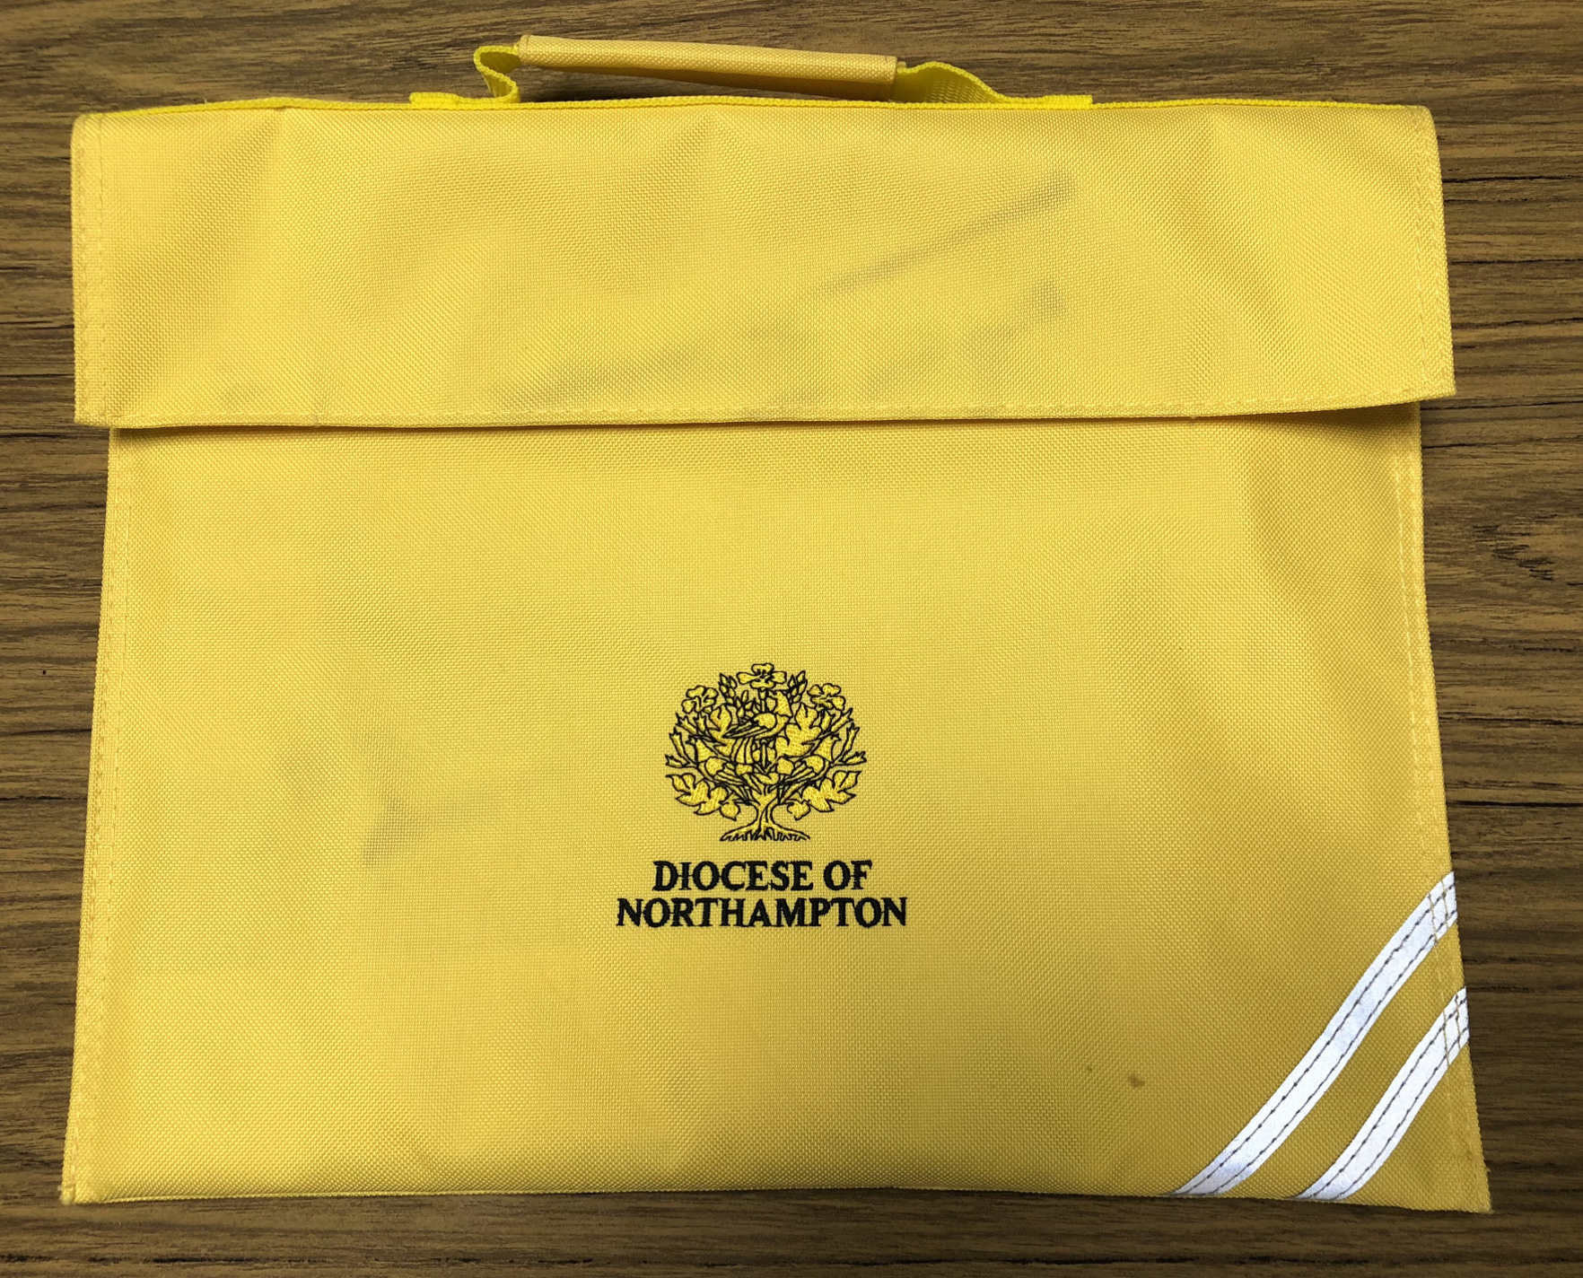
Virtual Family Prayer Bag
Dear Parent / Carer,
here is an electronic version of our Prayer Bag
for the Feast of Our Lady of Lourdes
Celebrating Our Lady of Lourdes
Please take some time over the next few days
to come together, as a family, in prayer.
Our Lady of Lourdes is celebrated on 11th February.

Slide 2
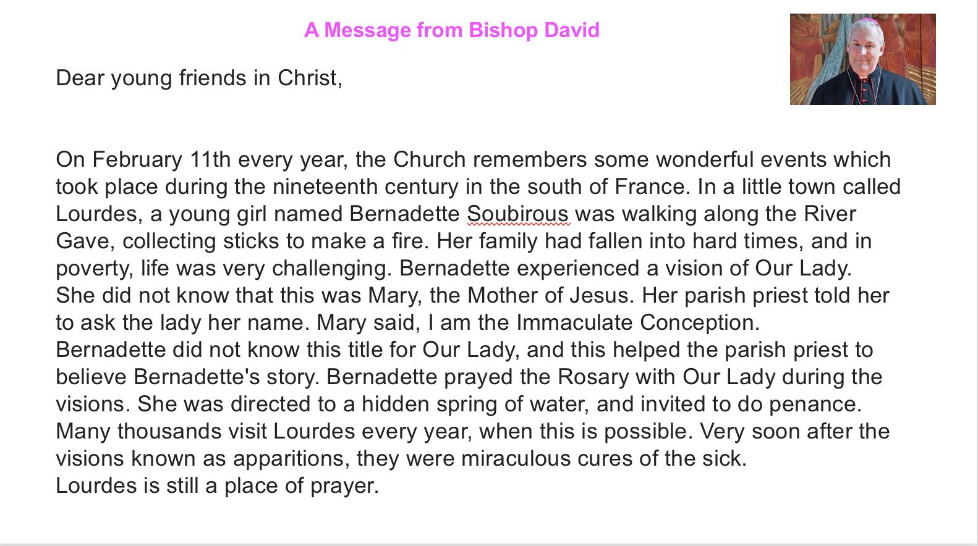

Slide 3
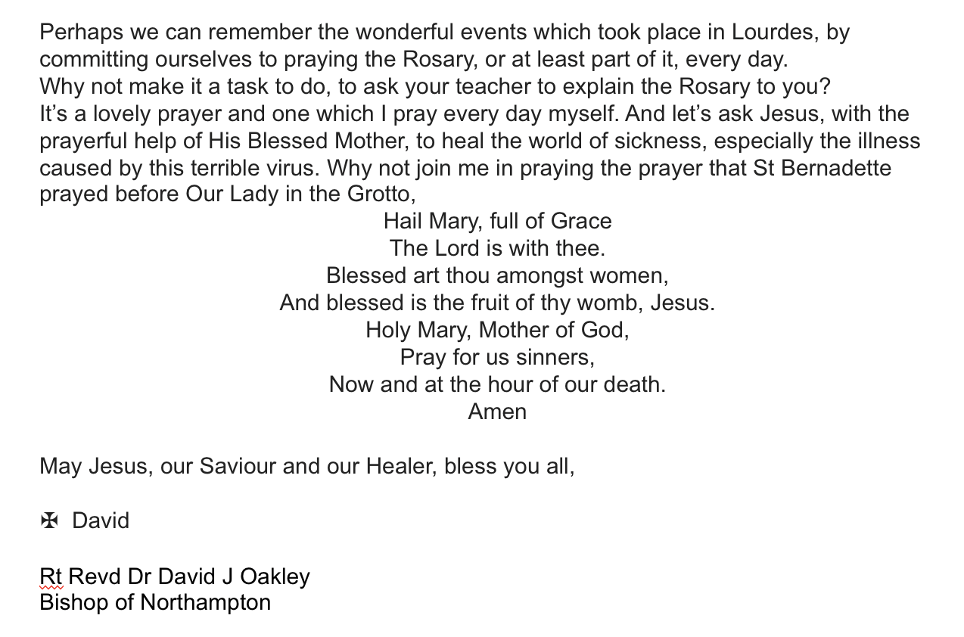

Slide 4
Gathering
Set aside some time in your day
to gather together for prayer
Make sure you are all sitting comfortably
Light a candle
In the name of the Father and of the Son and of the Holy Spirit. Amen
Notes:
Begin with the sign of the cross

Slide 5
Our Lady of Lourdes

Slide 6
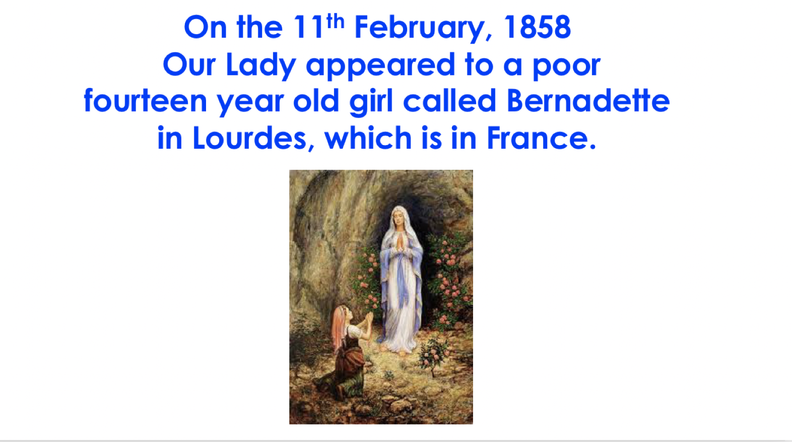

Slide 7
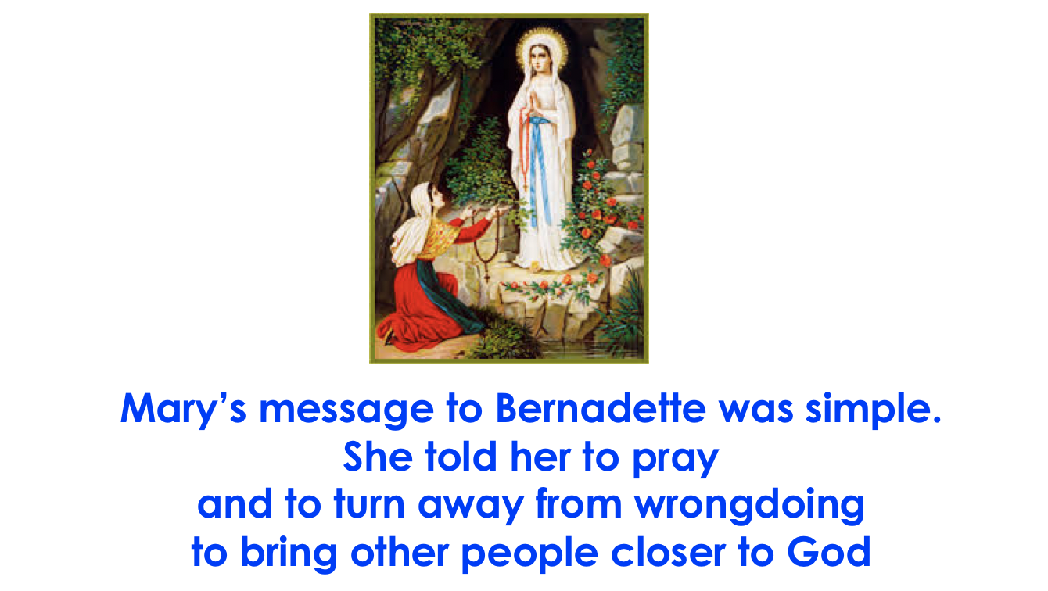

Slide 8
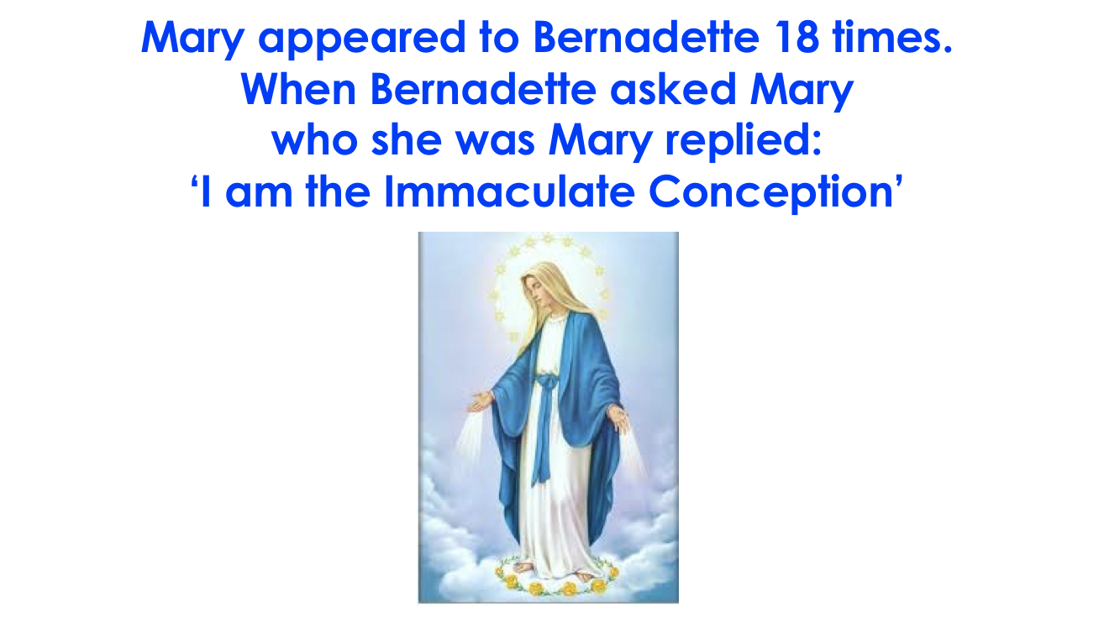

Slide 9
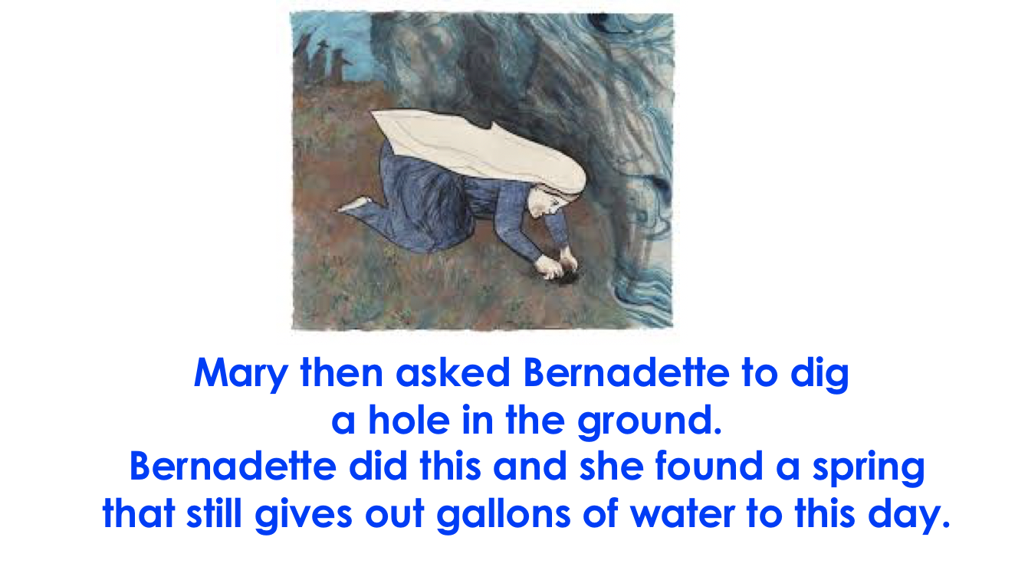

Slide 10


Slide 11
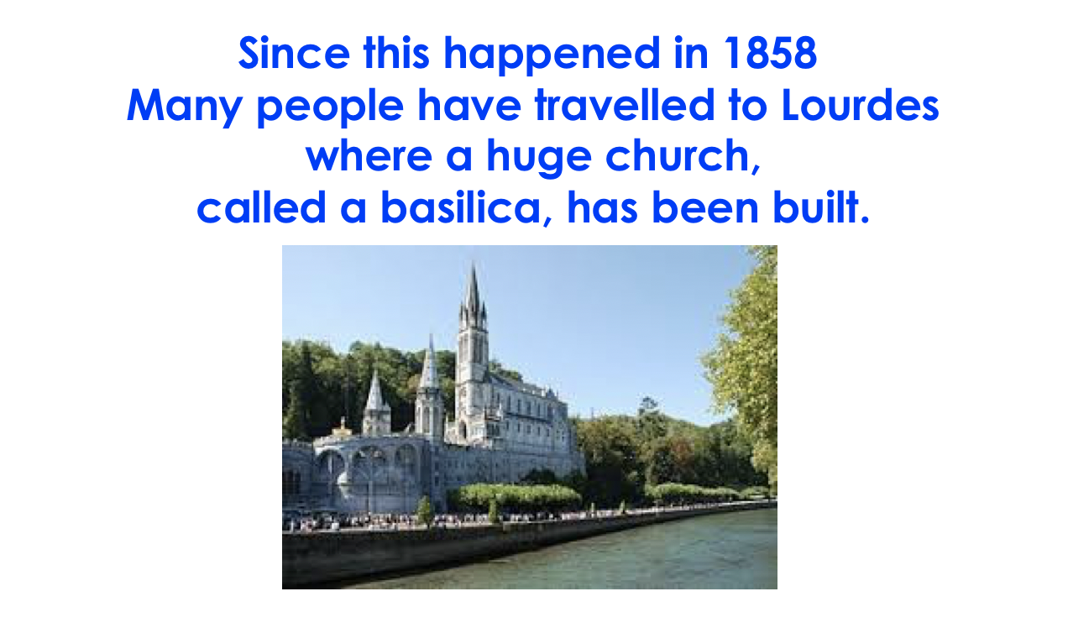

Slide 12
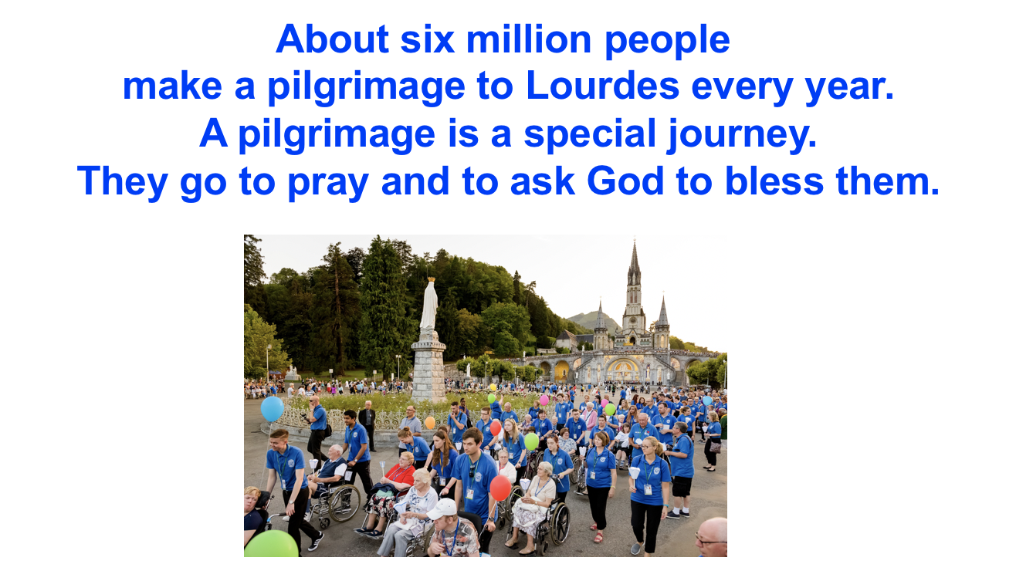

Slide 13


Slide 14
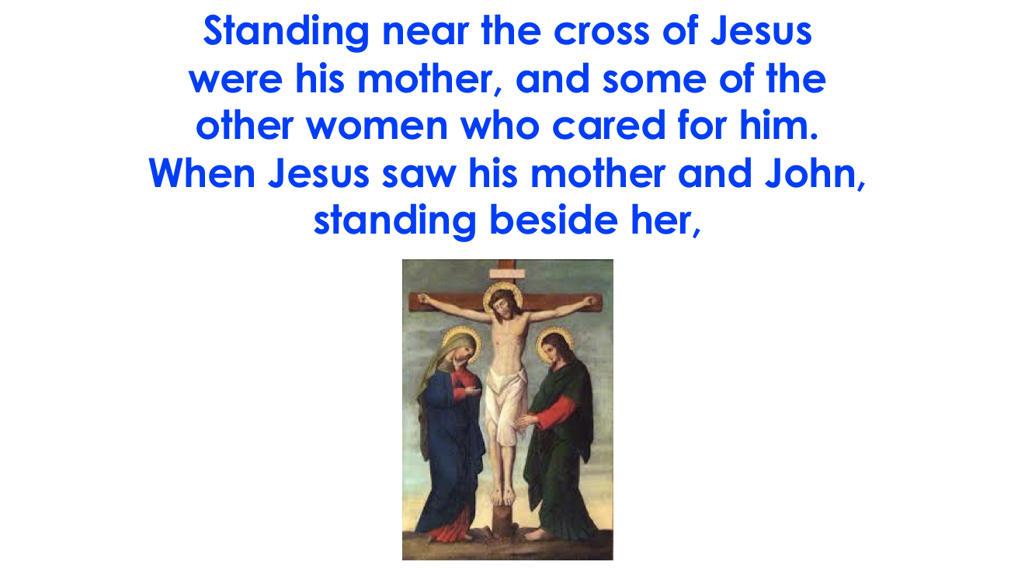

Slide 15
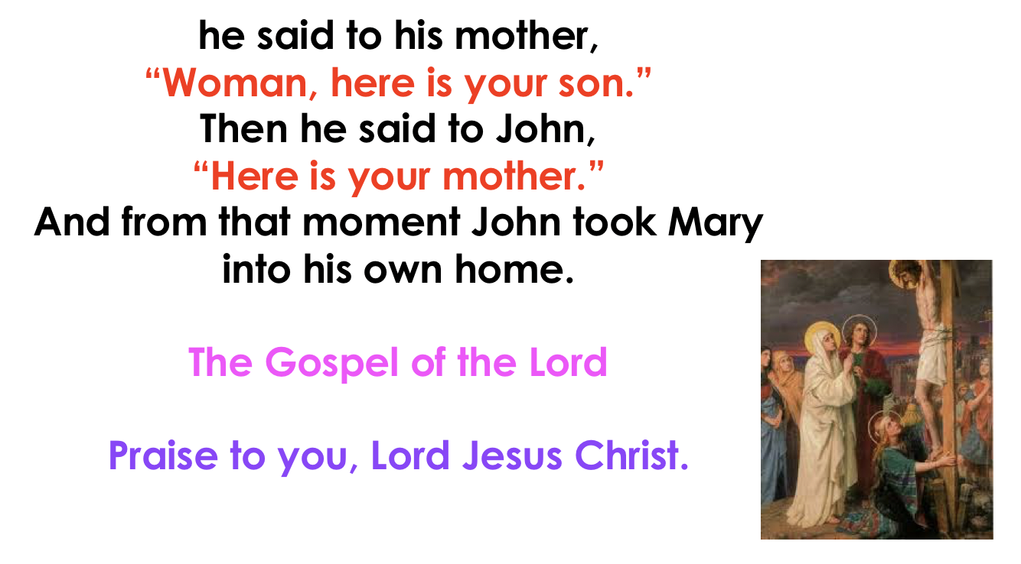

Slide 16
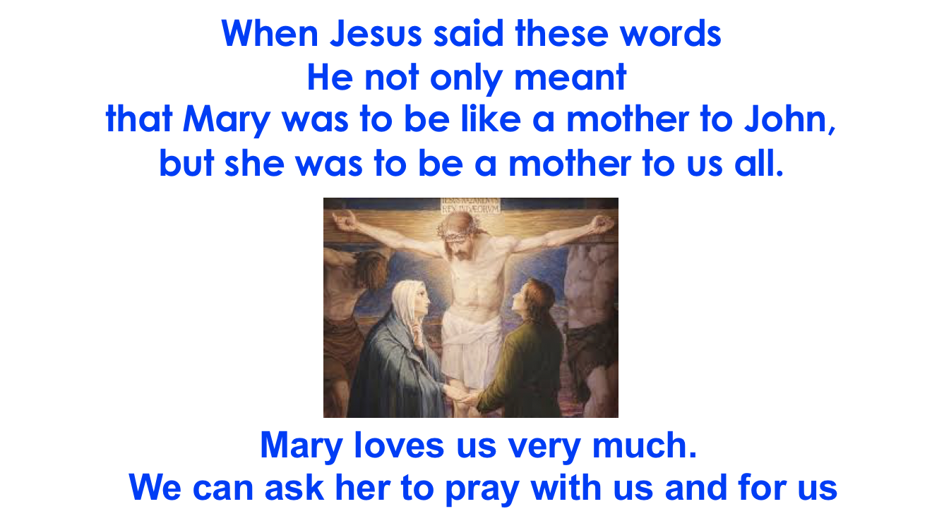

Slide 17
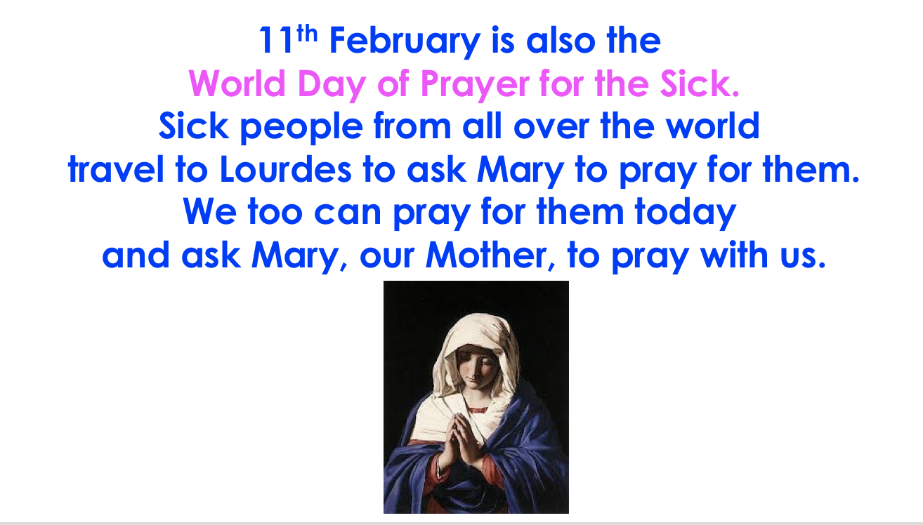

Slide 18
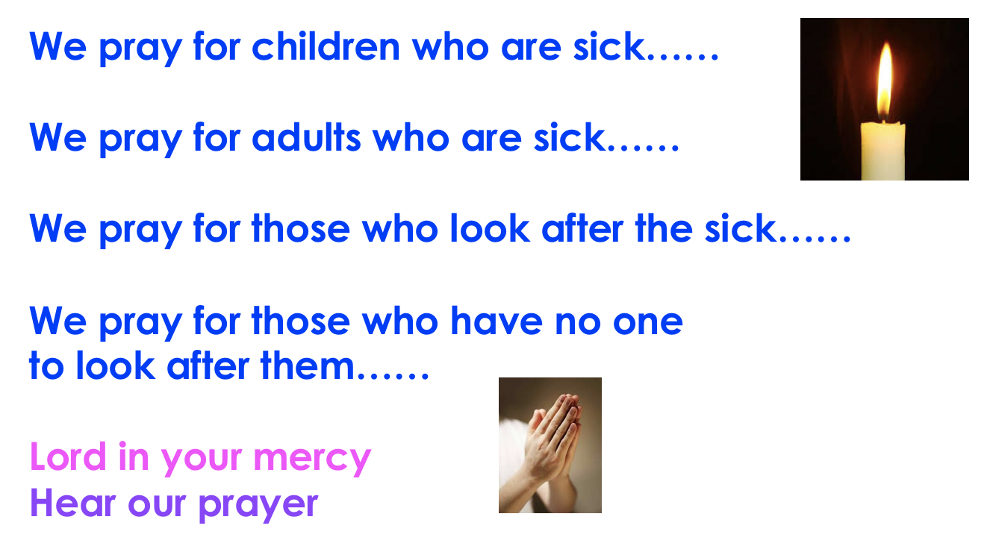

Slide 19
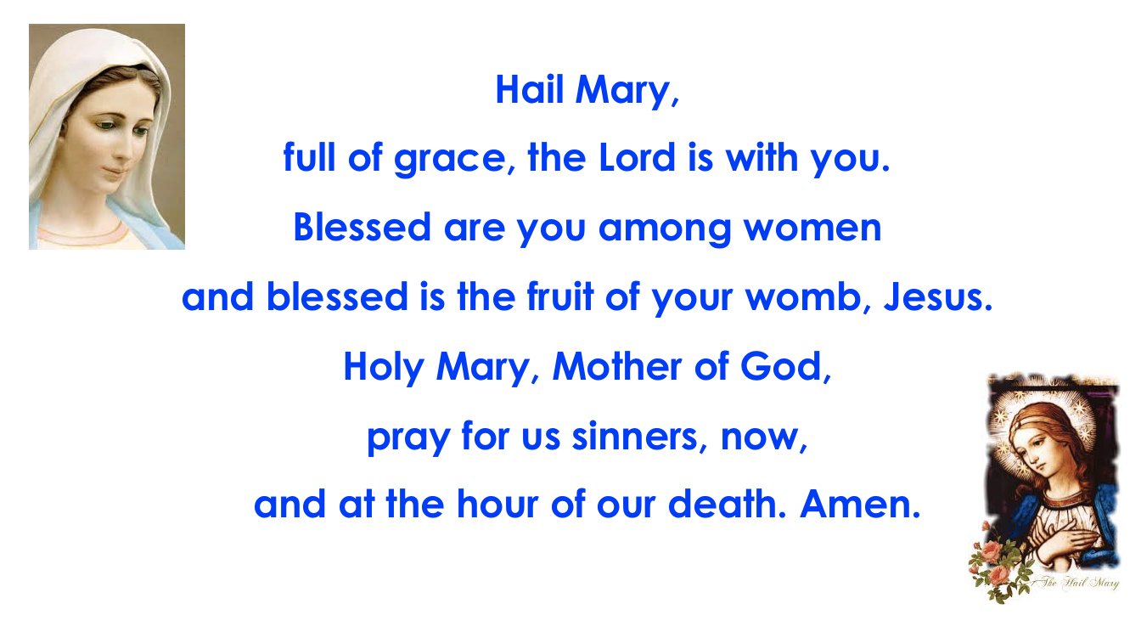

Slide 20
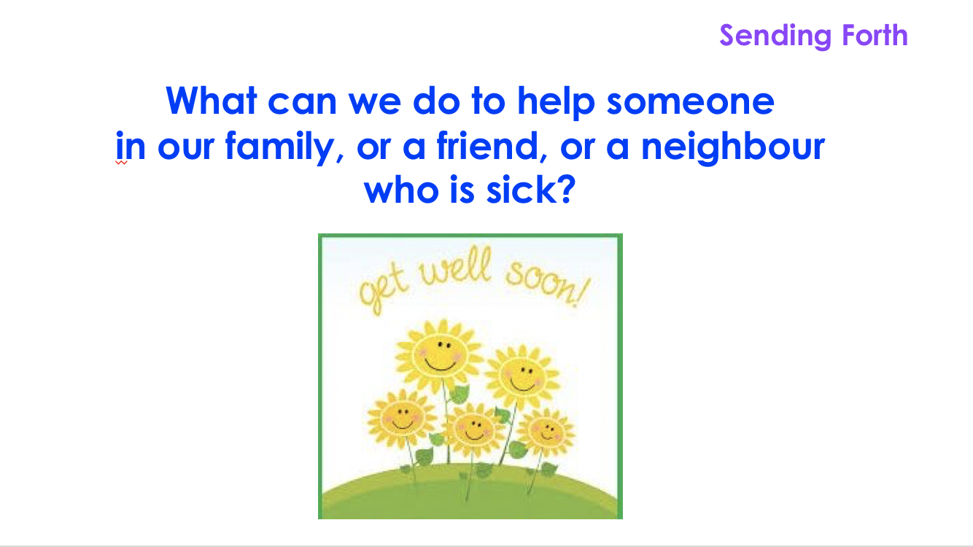

Slide 21


Slide 22
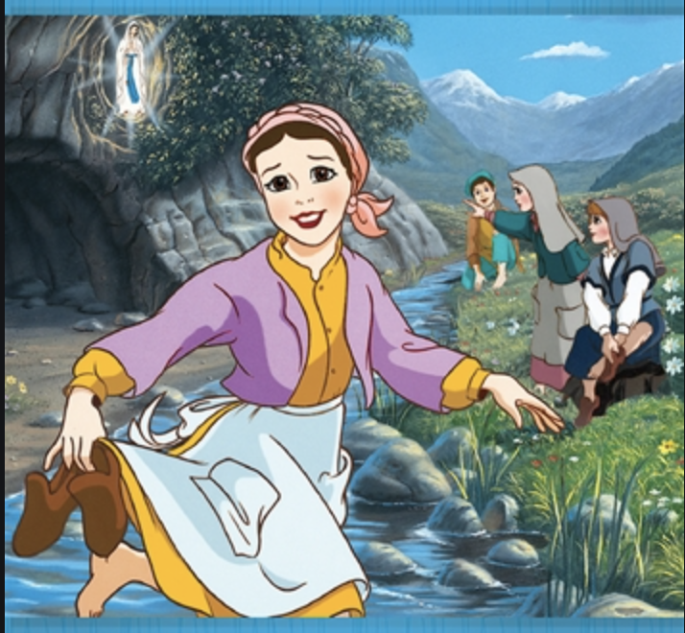
Click on the link below
to watch the Story of Bernadette of Lourdes
The Story of Saint Bernadette

