Slide 1

The First Sunday of Lent
Mark 1:12-15
Year B
https://www.youtube.com/watch?v=LuvfMDhTyMA

Slide 2

Gospel
The Spirit drove Jesus out into the wilderness and he remained there for forty days,and was tempted by Satan. He was with the wild beasts, and the angels looked after him.
After John had been arrested, Jesus went into Galilee. There he proclaimed the Good News from God. ‘The time has come’ he said ‘and the kingdom of God is close at hand. Repent and believe the Good News.’ Mark 1:12-15

Slide 3
Reflection
In this very short gospel, we learn that Jesus spent 40 days and night in the desert in a time of fasting and reflection. At the end of that time, when he was feeling weak with hunger and very vulnerable, the devil came to tempt him. To resist the temptation of doing the wrong thing Jesus asked God for help, quoting words from Scripture showing how much he believed in God’s word. When He needed God, knew that God was there for Him, which gave Him the strength to go out and to spread the Good News of God’s love.
During Lent we should turn away from ‘temptation’ or making the wrong choices, living our lives in a way that allows others to know about God’s love. Just as Jesus was looked after by the angels, God also supports us in our struggles. We succeed because Jesus conquered sin by His death on the cross. God will send angels to help us…look out for the face of Jesus in those around you.

Slide 4

In St Paul’s letter to the people of Corinth this is how he describes God’s love.
Can we be this much love for others?
How can I……put God’s word into action in Lent 2021?
Do I …show patience? At home, in school, with my family, with my friends or with my teachers?
Am I……generous? Or envious of what others have?
Am I…humble or am I boastful?
Am I…hopeful? Do I persevere and look for solutions in times of difficulty?
How do I…show kindness towards others and myself?
How do I……show generosity rather than envy?
Do I…always trust in God?
Do I ask him for help… To give thanks… To say sorry and admit when I am wrong?
1 Corinthians 13:4

Slide 5
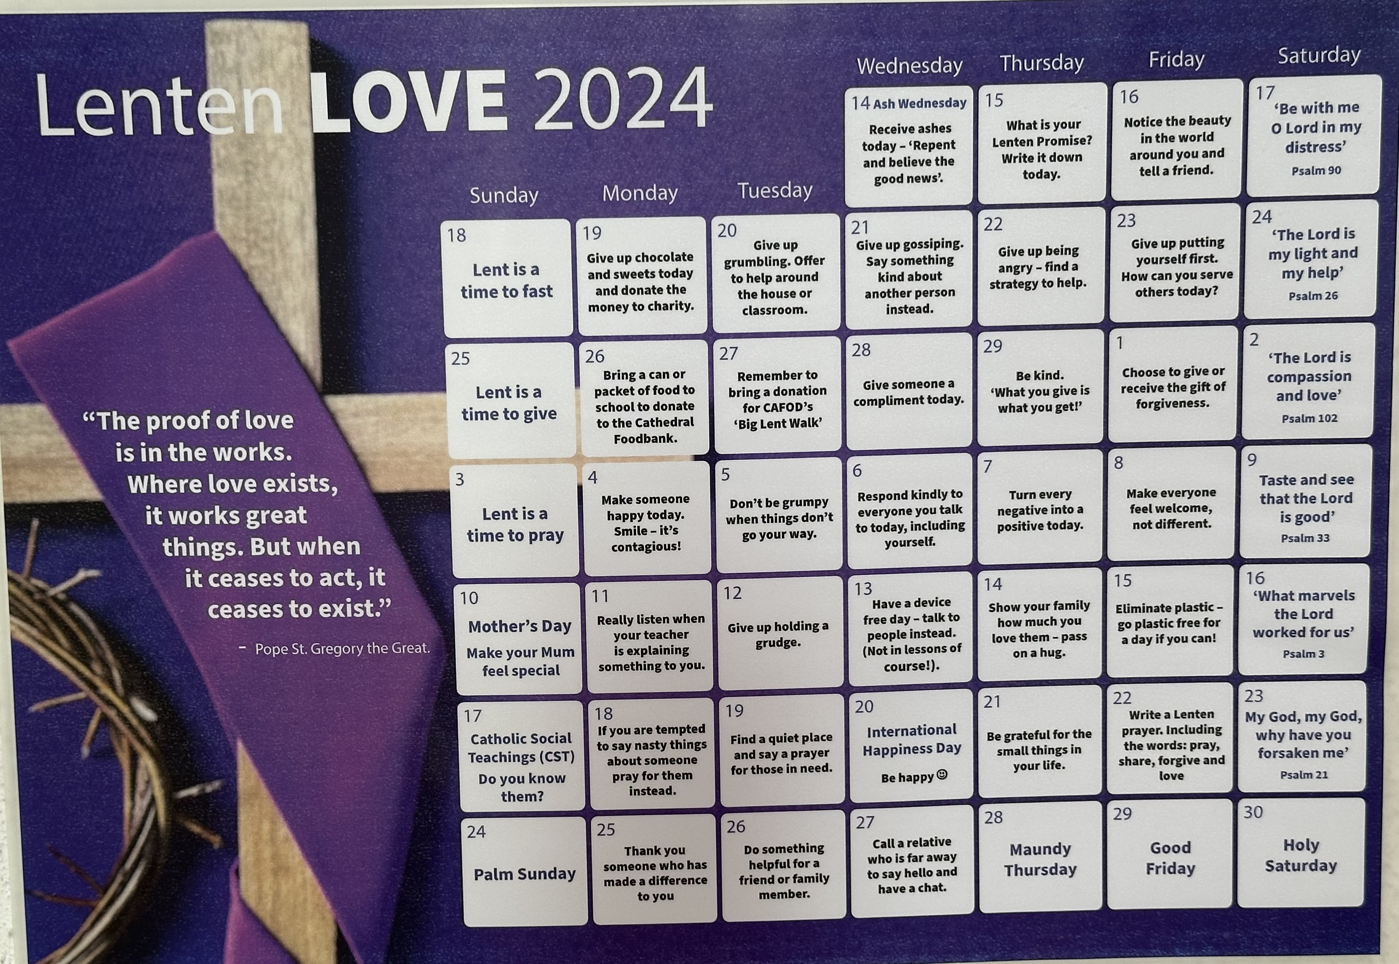
Post-it Challenge:
Use the Lent in Lockdown Calendar in your classroom/home to be inspired: Make a promise to look at it each day and make the changes in yourself.

Slide 6


Lent is a time to pray more, help those in need and fast.
Praying will help you build your relationship with God and help others at the same time.
Fasting may mean that you give up bad habits not just food – remember to make your actions benefit others…
Keep the acts of kindness going in Lent!
“Love brings us out of ourselves and creates bonds of sharing and community. Love is a leap of the heart, a gift that gives meaning to our lives,” Pope Francis. Lent 2021.

Slide 7

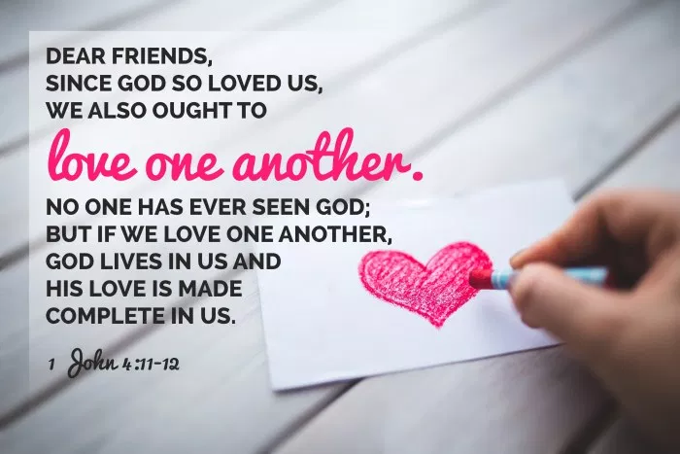
Let us pray:
Lord, help us to be strong in our resolutions for Lent. Let everything we do or do not do, be for the benefit of others. Allow us to spread ripples of happiness around our schools and our homes during this Lenten season so that we show God’s great love for us in our thoughts, our words and our actions. We ask this in Jesus' name. Amen

