Slide 1

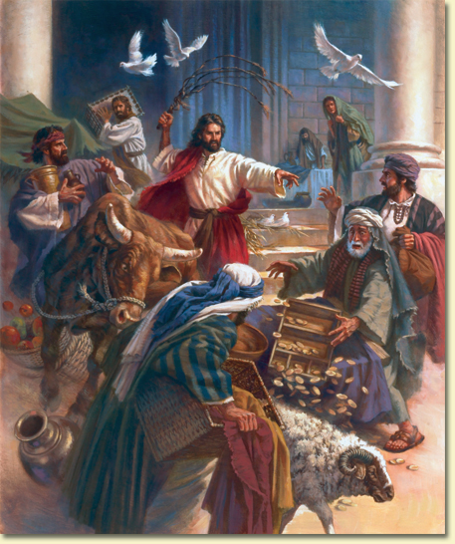
Gospel
3rd Sunday of Lent Year B
‘Destroy this sanctuary and in three days I will raise it up’
John 2:13-25
https://www.youtube.com/watch?v=ZHN8c0DiXNg

Slide 2

A Reading from the Holy Gospel according to John
Just before the Jewish Passover Jesus went up to Jerusalem, and in the Temple, he found people selling cattle and sheep and pigeons, and the money-changers sitting at their counters there. Making a whip out of some cord, he drove them all out of the Temple, cattle and sheep as well, scattered the money-changers’ coins, knocked their tables over and said to the pigeon-sellers, ‘Take all this out of here and stop turning my Father’s house into
a market.’ Then his disciples remembered the words of scripture: ‘Zeal for your house will devour me.’ The Jews intervened and said, ‘What sign can you show us to justify what you have done?’ Jesus answered, ‘Destroy this sanctuary, and in three days I will raise it up.’ The Jews replied, ‘It has taken forty-six years to build this sanctuary: are you going to raise it up in three days?’ But he was speaking of the sanctuary that was his body, and when Jesus rose from the dead, his disciples remembered that he had said this, and they believed the scripture and the words he had said.
During his stay in Jerusalem for the Passover many believed in his name when they saw the signs that he gave, but Jesus knew them all and did not trust himself to them; he never needed evidence about any man; he could tell what a man had in him. John 2:13-25

Slide 3
In today’s Gospel we hear about how Jesus becomes angry when he sees something that he does not think is right.
Jesus goes into the Temple and sees all the money changers sitting at their counters. The visitors are given the coins needed to spend and use in the Temple. Of course, they charge a fee! Jesus is very upset that they are cashing in on religion. This is not helped by the fact that people are also selling offerings for sacrifice such as cattle, sheep and pigeons.
Jesus becomes angry, turning over the tables and chasing the money lenders and merchants from the Temple. He is standing up for what He believes in.
The Jewish law urges people to care for those in need. Once again, the Jewish religious leaders ‘talk the talk’ but do not put words into action!
It is ironic that those entering the temple were immediately being asked to change their money. However, what was actually needed was an internal change, a change of attitude, in fact, a change of heart. Instead of changing money, the people needed to change themselves! They needed to repent!
cont…

Slide 4
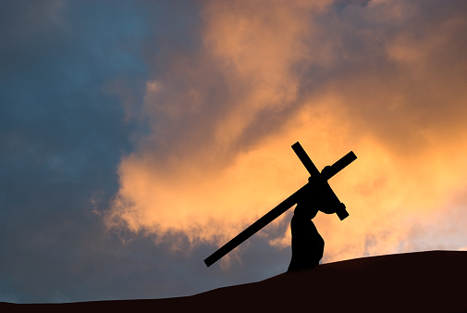
Cont…
…When asked what sign would he give to justify his turning over of the tables, Jesus tells them that ‘this sanctuary will be destroyed and will be raised again in three days’. Here, Jesus is speaking not about the temple as they think but about His own death and resurrection, the ultimate sacrifice.
“Go out into the world today and love the people you meet. Let your presence light new light in the hearts of people.”
Saint Teresa of Calcutta

Slide 5


Post-it challenge:
In this Gospel, the stallholders and the Temple authorities seem to have lost sight of God, whom they should have been serving by the way they treated other people.
How can we make sure this does not happen to us?
Consider the attitude of the Jewish authorities compared to the disciples? - What is their attitude to Jesus’ words and actions? Why is this?
If we have ‘a change of heart’ this Lent, how will this change us and affect those people we love?

Slide 6

Grant us, Lord God, a vision of your world as your love would have it: a world where the weak are protected, and none go hungry or poor; a world where peace is built with justice, and justice is guided by love. Give us the inspiration and courage to build this world, through Jesus Christ our Lord. Amen Francis Xavier
St Thomas – Pray for us.

Slide 7

With God on your side…..
You are braver than you believe, stronger than you seem, smarter than you think and loved more than you will ever know.
Winnie The Pooh

