Slide 1
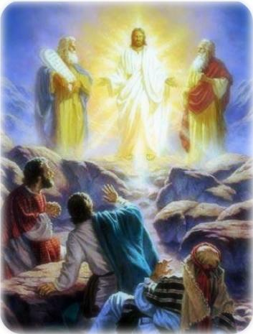
Gospel for the 2nd Sunday of Lent, Year B
The Transfiguration of Jesus Matthew 17:1-9
‘This is my Son, the Chosen One. Listen to him.’
Reckless Love - [Lyric Video] Cory Asbury - YouTube
https://www.youtube.com/watch?v=Xo1mjuy1NA0

Slide 2
Gospel
Jesus took with him Peter and John and James and went up the mountain to pray. As he prayed, the aspect of his face was changed, and his clothing became brilliant as lightning. Suddenly there were two men there talking to him; they were Moses and Elijah appearing in glory, and they were speaking of his passing which he was to accomplish in Jerusalem. Peter and his companions were heavy with sleep, but they kept awake and saw his glory and the two men standing with him. As these were leaving him, Peter said to Jesus, ‘Master, it is wonderful for us to be here; so, let us make three tents, one for you, one for Moses and one for Elijah.’ – He did not know what he was saying. As he spoke, a cloud came and covered them with shadow; and when they went into the cloud the disciples were afraid. And a voice came from the cloud saying, ‘This is my Son, the Chosen One. Listen to him.’ And after the voice had spoken, Jesus was found alone. The disciples kept silence and, at that time, told no-one what they had seen. Luke 9:28-3

Slide 3
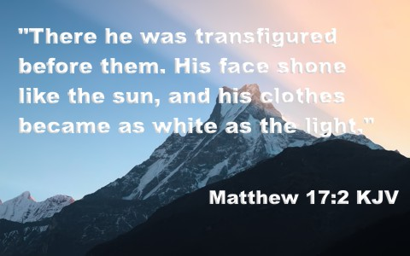
Reflection On the first Sunday of Lent, the Gospel always tells the story of Jesus' temptation in the desert. On the second Sunday, we always hear the story of Jesus' Transfiguration. In this Gospel we see a glimpse of the glory that would come for Jesus after His death and resurrection. When Peter woke up and saw Jesus surrounded by light and standing with Moses and Elijah he was confused. Then God’s voice spoke from Heaven commanding that the disciples listen to him. This was to give encouragement to the disciples as they came to realise that Jesus really is the Son of God. Jesus is changed… And everything changes for the disciples … And for us too!

Slide 4

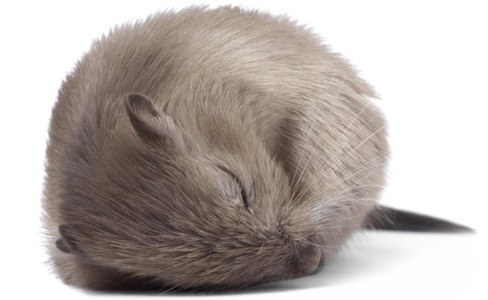

…Peter, James and John almost missed something important because they were sleeping. If the disciples had stayed asleep, they would have missed this amazing event. They would not have seen Jesus in all His glory. They would not have heard the voice from Heaven. Our lives can be like this. We can be asleep, not recognizing that Jesus is with us always. During Lent, we try to “wake up” to see Jesus more clearly and to listen to what he tells us and act on it.

Slide 5
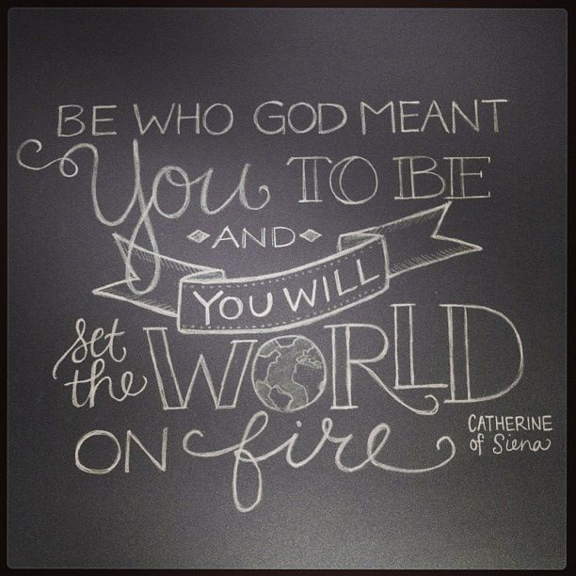
‘If you are what you should be you will set the whole world ablaze.’ St Catherine of Siena
The appearance of Moses and Elijah on the mountain and the sound of God’s voice gave encouragement to Jesus to continue His mission, even though the most difficult times were yet to come.
Post-it challenge:
Write one way in which you can give encouragement to someone who is finding life difficult at the moment.
By living as God asks us to, you can also change the lives of other people and help them in so many ways.
Remember to LOL – Love out Loud!

Slide 6
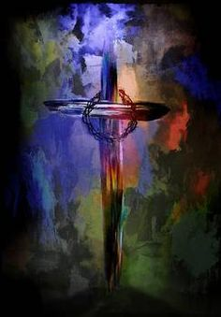
Let us pray:
God our Father, help us to see Jesus in all people and to treat them as we would wish to be treated ourselves. Let us always be ready to encourage and motivate others, often in the small everyday tasks in life.
Help us to ‘stay awake’ and listen and to live our lives as you ask us to. Amen.

Slide 7



