Slide 1
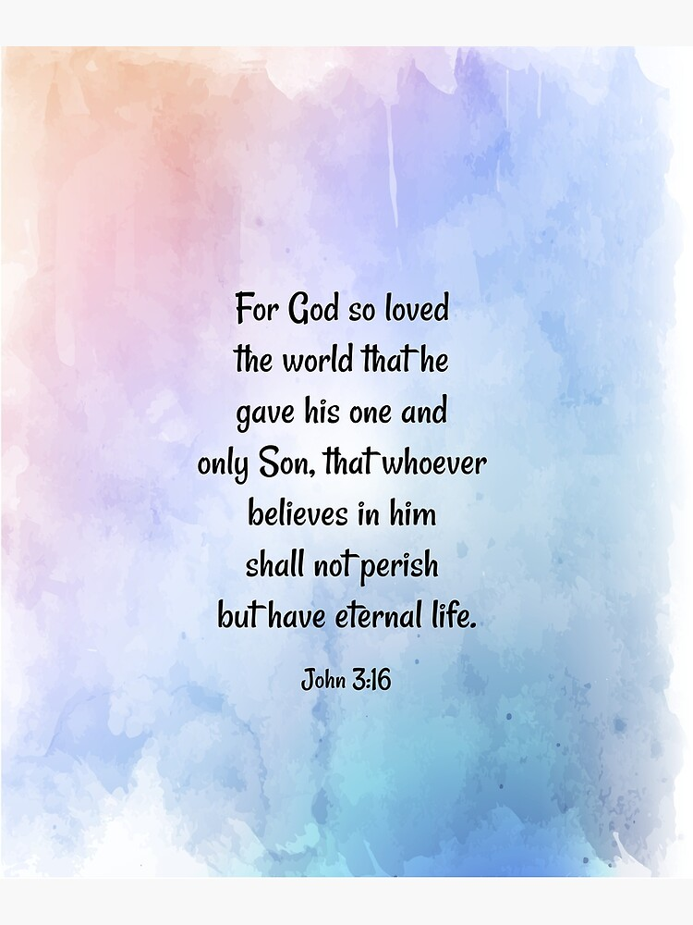
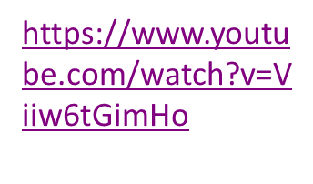
Gospel
4th Sunday of Lent Year B
‘God so loved the world…’
John 3:14-21

Slide 2

Gospel
Jesus said to Nicodemus: ‘The Son of Man must be lifted up as Moses lifted up the serpent in the desert, so that everyone who believes may have eternal life in him. Yes, God loved the world so much that he gave his only Son, so that everyone who believes in him may not be lost but may have eternal life. For God sent his Son into the world not to condemn the world, but so that through him the world might be saved. No one who believes in him will be condemned; but whoever refuses to believe is condemned already, because he has refused to believe in the name of God’s only Son…

Slide 3
Cont…
…On these grounds is sentence pronounced: that though the light has come into the world men have shown they prefer darkness to the light because their deeds were evil. And indeed, everybody who does wrong hates the light and avoids it, for fear his actions should be exposed; but the man who lives by the truth comes out into the light, so that it may be plainly seen that what he does is done in God.’ John 3:14-21

Slide 4
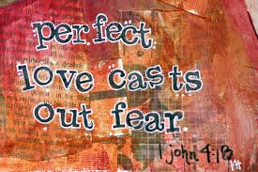
Reflection
Once again, we find ourselves listening to the words from John this week. Through Jesus’ conversation with Nicodemus, we learn a little more about human sinfulness. Jesus is the light coming into the world, but people prefer darkness and want to keep their sins hidden, even from God! The Good News which we celebrate in Lent and throughout life, is that through God’s love, Jesus came to reveal our sins so that we could be forgiven. So, Jesus came into our world to save it by His death on the cross and His resurrection from the dead. If we follow the light, the light will show us the way!
Cont…

Slide 5

…
In the difficult times we live in today, where people are feeling overwhelmed and overburdened, we should remember that our fears always matter to God. The truth is, all of us are inadequate; we are never enough…
…but here is the incredible thing, when we are weak, God’s power is made perfect. When life is hard, we should accept that we are weak, and God is there for us. We should hand our fears over to God. He will build our faith. His presence, his power and his spirit will guide us; his word will strengthen us. His love will shine through us and we will clearly see the face of Christ in others.
Let God’s light shine out through you today!

Slide 6

Post-it Challenge John 3:16 is one of the most quoted verses in the Bible. Read this verse over several times. Ask God to deepen your understanding of what this promise means for you and people you know.
‘Yes, God loved the world so much that he gave his only Son, so that everyone who believes in him may not be lost but may have eternal life.’
Remember to take time to listen carefully too…
… in case God wants to speak to you in return!

Slide 7
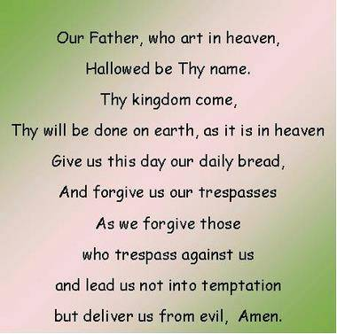
Let us Pray:

