Slide 1

Gospel Reflection
The First Sunday of Advent
“Stay awake, be ready” Mark 13:33-37

Slide 2
A Reading from the Holy Gospel according to Mark
Jesus said to his disciples: ‘Be on your guard, stay awake, because you never know when the time will come. And what I say to you I say to all: Stay awake!’ The Word of the Lord
https://www.youtube.com/watch?v=dSn9HW5P-sA
https://bustedhalo.com/video/advent-in-two-minutes

Slide 3
Gospel Reflection
Advent is the beginning of the new Church Year, the season of hope, ending with the birth of Jesus, bringing the good news that we are loved unconditionally by God. This is a good time of year to make a fresh start, making sure that we make the right choices every day. On the Advent wreath, a candle is lit each Sunday to bring us closer to the light of Jesus at Christmas. The first Advent candle is a symbol of hope. In the Gospel, Jesus tells us to be good and kind children while we are waiting, so that we will be ready when He comes on Christmas Day.

Slide 4
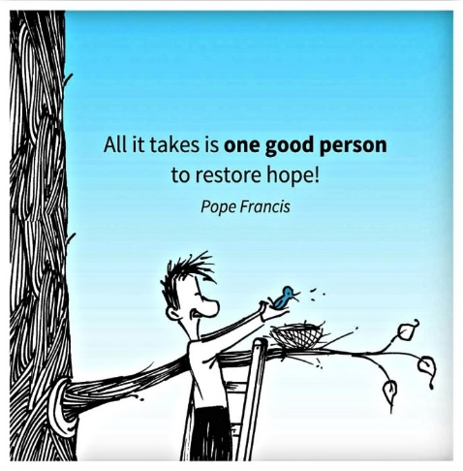

Post-it Challenge
.
What do you think we mean by ‘hope’?
What are you hoping for today?
Write one small action that will help you bring hope to someone in your life today.

Slide 5

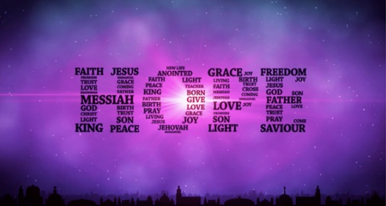
Thursday
Purple is the colour of Advent.
The first candle is for hope
Advent is like springtime, when everything is renewed and so is fresh and healthy.’
St Mother Teresa of Calcutta

Slide 6

Friday
An Advent prayer
Dear Jesus,
Let your light shine within us
So that through our actions we may show hope and kindness to everyone we meet, especially to those in need.
Amen
https://www.youtube.com/watch?v=lCfpDyrfPk0

