Slide 1

Gospel Reflection
The Second Sunday of Advent
Matthew3:1-11
https://www.youtube.com/watch?v=cZVjXsf_7aI
https://bustedhalo.com/video/advent-in-two-minutes

Slide 2
Gospel In those days John the Baptist came, preaching in the wilderness of Judea and saying, “Repent, for the kingdom of heaven has come near.” This is he who was spoken of through the prophet Isaiah: “A voice of one calling in the wilderness, ‘Prepare the way for the Lord, make straight paths for him.’” John’s clothes were made of camel’s hair, and he had a leather belt around his waist. His food was locusts and wild honey. People went out to him from Jerusalem and all Judea and the whole region of the Jordan. Confessing their sins, they were baptized by him in the Jordan River. But when he saw many of the Pharisees and Sadducees coming to where he was baptizing, he said to them: “You brood of vipers! Who warned you to flee from the coming wrath? “I baptize you with water for repentance. But after me comes one who is more powerful than I, whose sandals I am not worthy to carry. He will baptize you with the Holy Spirit and fire.”

Slide 3
Gospel Reflection
This week’s Gospel invites us to consider the teachings of John the Baptist. So, what is John’s mission? He is calling on people, on us, to prepare for the Lord’s coming. As John's message prepared the way for Jesus, we too are called to prepare ourselves for Jesus' coming at Christmas by showing ‘repentance’ and a ‘change of heart’. We can respond to John's message by making changes in our lives, considering our actions and thinking about what we can do better. The season of Advent is a time for us to focus on making good choices so that we have tried to be ready to receive Jesus into our hearts. How will you change your heart this Christmas? What will you do differently?

Slide 4
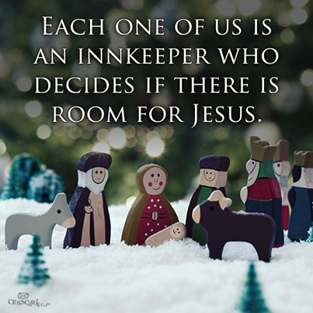
.
Post-it Challenge:
Will you make room for Jesus in your life? How can you do this? Share your answers with a friend.
Consider: your thoughts, your words, your actions… When you become the person Jesus wants you to be the impact on those around you will be huge.

Slide 5

‘Prepare the Way of the Lord’
“It is the beautiful task of Advent to awaken in all of us memories of goodness and thus to open doors of hope.” Pope Benedict XV1

Slide 6
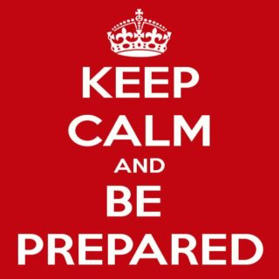
Is The message of John the Baptist still relevant today?
If I am ready to let Jesus into my heart, then will I change my behaviour and the way I treat others.
Am I greedy for material possessions or for justice and truth?

Slide 7
An Advent prayer
In this season of Advent,
as we wait in joyful hope
for the coming of your Son
Let us take time to pause in our busy lives, to prepare our hearts and minds.
Let your light shine within us
So that through our actions we may show hope and kindness to everyone we meet, especially to those in need.
Amen

