Slide 1

Gospel for The Second Sunday of Advent ~ Year B
Mark 1:1-8
https://www.youtube.com/watch?v=crCOskHpIUI&list=PLs-yvZlMqrNUHmy6m-5C4eGUYtHs_Yn-0&index=10

Slide 2
A Reading from the Holy Gospel according to Mark The beginning of the Good News about Jesus Christ, the Son of God. It is written in the book of the prophet Isaiah: Look, I am going to send my messenger before you; he will prepare your way. A voice cries in the wilderness: Prepare a way for the Lord, make His paths straight.

Slide 3

Gospel Reflection
In this week’s Gospel, John the Baptist is calling on people, on us, to prepare for the Lord’s coming. As John's message prepared the way for Jesus, we too are called to prepare ourselves for Jesus' coming at Christmas by showing we are sorry for making the wrong choices and by having a ‘change of heart’. The season of Advent is a time for us to focus on making good choices in our lives every single day so that we know that we have tried to be ready to receive Jesus into our hearts. How will you change your heart this Christmas? What will you do differently?

Slide 4
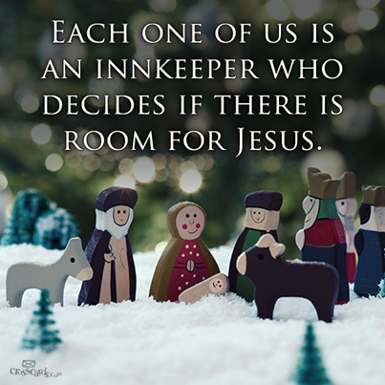
.
Post-it Challenge:
Will you make room for Jesus in your heart and in your life? How can you do this? Share your answers with a friend.

Slide 5

‘Prepare the Way of the Lord’
“It is the beautiful task of Advent to awaken in all of us memories of goodness and thus to open doors of hope.”
Pope Benedict XV1

Slide 6


Dear Jesus,
In this season of Advent,
Let your light shine within us
So that, through our actions we may show
hope and love to everyone we
meet today.
Amen
Let us Pray

