Slide 1

Gospel Reflection
The Third Sunday of Advent
John 1:6-8,19-28
https://www.youtube.com/watch?v=TM1XusYVqNY
https://www.youtube.com/watch?v=XyijhpaaEs8

Slide 2
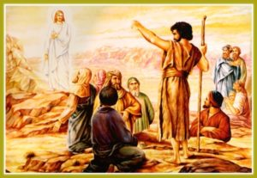
A Reading from the Holy Gospel
according to John
There was a man, sent by God.
His name was John.
He came as a witness,
as a witness to speak for the light,
so that everyone might believe through him.
He was not the light,
only a witness to speak for the light. John 1:6-8,
The Gospel of the Lord
Praise to you Lord Jesus Christ

Slide 3
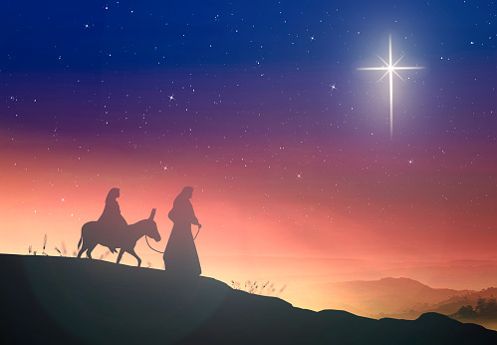
Gospel Reflection
This week the Advent message explains that the prophecy from the Old Testament is been fulfilled and that Jesus, a shining light coming to light up the darkness of the world.
John came as a witness to Jesus and the people listening to John believed his words and believed that he was a trustworthy witness.
This Advent season, we pray that we will recognise His presence in those around us and that we will continue to ‘stay awake’ and be watchful as we wait for the day when Jesus will come again.

Slide 4

The third Sunday of Advent is also known as Gaudete Sunday. The word ‘Gaudete’ is Latin for ‘Rejoice’. A pink candle instead of a purple one is lit on the Advent wreath. It is a reminder that Advent is a joyful season and that the time for the birth of Christ is almost here.
“For those who love, nothing is too difficult, especially when it is done for the love of Jesus Christ.”
St Ignatius Loyola

Slide 5
.
Post-it Challenge:
Will the people who know you realise that you understand the true meaning of Christmas?
How will your actions show them?
We are all part of one family, God’s family, and God asks us to love each other and care for each other.
How will you love and care for those around you this Christmas?

Slide 6

Let us pray
We pray for the children and young people of our schools, that they may become a shining example of God’s love, welcoming everyone and spreading the message of Christ to all people.
Amen.

