Slide 1
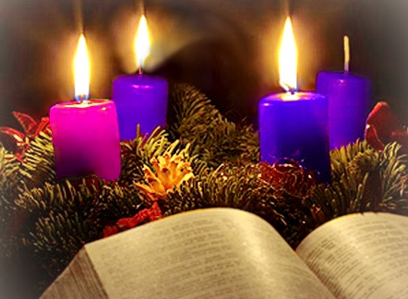
Gospel Reflection
The Third Sunday of Advent
John 1:6-8,19-28
https://www.youtube.com/watch?v=TM1XusYVqNY
https://www.youtube.com/watch?v=XyijhpaaEs8

Slide 2
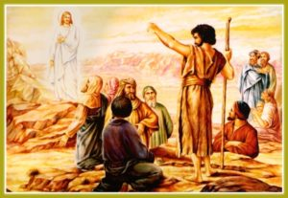
Gospel:
A man came, sent by God.
His name was John.
He came as a witness,
as a witness to speak for the light,
so that everyone might believe through him.
He was not the light,
only a witness to speak for the light.
This is how John appeared as a witness. When the Jews sent priests and Levites from Jerusalem to ask him, ‘Who are you?’ he not only declared, but he declared quite openly, ‘I am not the Christ.’ ‘Well then,’ they asked ‘are you Elijah?’ ‘I am not’ he said. ‘Are you the Prophet?’ He answered, ‘No.’ So they said to him, ‘Who are you? We must take back an answer to those who sent us. What have you to say about yourself?’ So, John said,
‘I am, as Isaiah prophesied:
a voice that cries in the wilderness:
Make a straight way for the Lord.’
Now these men had been sent by the Pharisees, and they put this further question to him, ‘Why are you baptising if you are not the Christ, and not Elijah, and not the prophet?’ John replied, ‘I baptise with water; but there stands among you – unknown to you – the one who is coming after me; and I am not fit to undo his sandal-strap.’
John 1:6-8,19-28

Slide 3
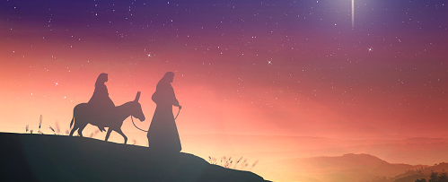
Gospel Reflection
This week the Advent message comes from John’s Gospel. It explains that the prophecy from the Old Testament is been fulfilled and that Jesus, a shining light coming to light up the darkness of the world. It also emphasises the relationship between John the Baptist and Jesus. John tells the priests and Levites, he is not the Messiah, he is not Elijah, and he is not the prophet. John came as a witness to Jesus and the people listening to John believed his words and believed that he was a trustworthy witness.
A second important Advent theme running through this Gospel tells us that Jesus has already come into the world as our Saviour. This Advent season, we pray that we will recognise His presence in those around us and that we will continue to ‘stay awake’ and be watchful as we wait for the day when Jesus will come again.

Slide 4
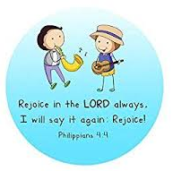
The third Sunday of Advent is also known as Gaudete Sunday. The word ‘Gaudete’ is Latin for ‘Rejoice’. A pink candle instead of a purple one is lit on the Advent wreath. It is a reminder that Advent is a joyful season and that the time for the birth of Christ is almost here.
“For those who love, nothing is too difficult, especially when it is done for the love of Jesus Christ.”
St Ignatius Loyola

Slide 5
.
Post-it Challenge:
“He came as a Witness”
How can you be a witness to speak for Jesus with your friends and family this Christmas?
Will the people who know you realise that you understand the true meaning of Christmas?
How will your actions show them?
We are all part of one family, God’s family, and God asks us to love each other and care for each other.
How will you love and care for those around you this Christmas?

Slide 6

Let us pray
We pray for the children and young people of our schools, that they may become a shining example of God’s love, welcoming everyone and spreading the message of Christ to all people.
Help us all to prepare, to change our lives to be ready when you come, and to share what we have so that all people may have what they need. Amen.
St Thomas, pray for us.

