Slide 1
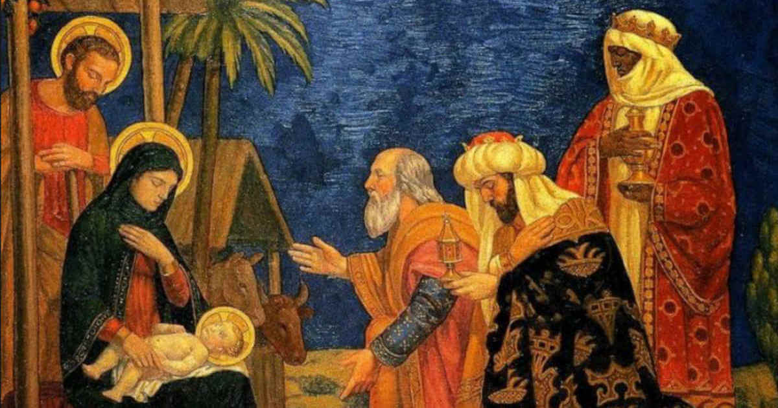
The Epiphany of the Lord
Matthew 2:1-12
https://www.youtube.com/watch?v=OJao9nq-Ss4

Slide 2
A Reading from the Holy Gospel according to Matthew
After Jesus had been born at Bethlehem in Judaea during the reign of King Herod, some wise men came to Jerusalem from the east. And there in front of them was the star they had seen rising; it went forward, and halted over the place where the child was. The sight of the star filled them with delight, and going into the house they saw the child with his mother Mary, and falling to their knees they did him homage. Then, opening their treasures, they offered him gifts of gold and frankincense and myrrh.
Matthew 2:1-12 (extended version)

Slide 3
Gospel Reflection:
The feast of the Epiphany asks us to be like the Wise Men – children on a journey to Christ. They are searching for Jesus and want to welcome Him into their lives.
They follow the star in a journey of faith and for the ways of God. They were not put off on that journey, even by the difficulties they met on the way.
St Paul writes, "You will shine like stars in the sky”
The light of the Epiphany is given to us as a gift, but we cannot keep it to or for ourselves. Through how we behave in our daily lives and how we treat each other, we are called to make our families, homes, parishes, communities and the wider world a better and brighter place for all people, especially those in most need.

Slide 4

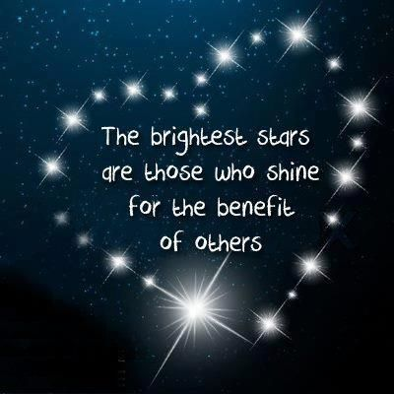
We do not always have a star to follow, to show us that we are following what God wants us to do.
God has given us Jesus, to show us how we should try to live our lives.
Post-it Challenge
How do we follow God in our lives?
How will you follow God in the coming week?

Slide 5
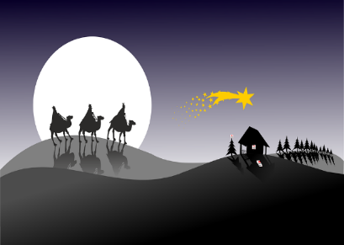
‘…they saw the child with his mother Mary…’
Post-it Challenge:
Imagine you are one of the wise men.
How would you have felt seeing Jesus in the stable?

Slide 6



What are your hopes and dreams for 2022?
Let us Pray:
Dear Jesus
Inspire and guide us in our hopes and dreams.
We pray for our schools, our families and our friends, that we may always be children of God.
May the Light of Christ be with us this day and always.
Amen.

