Slide 1
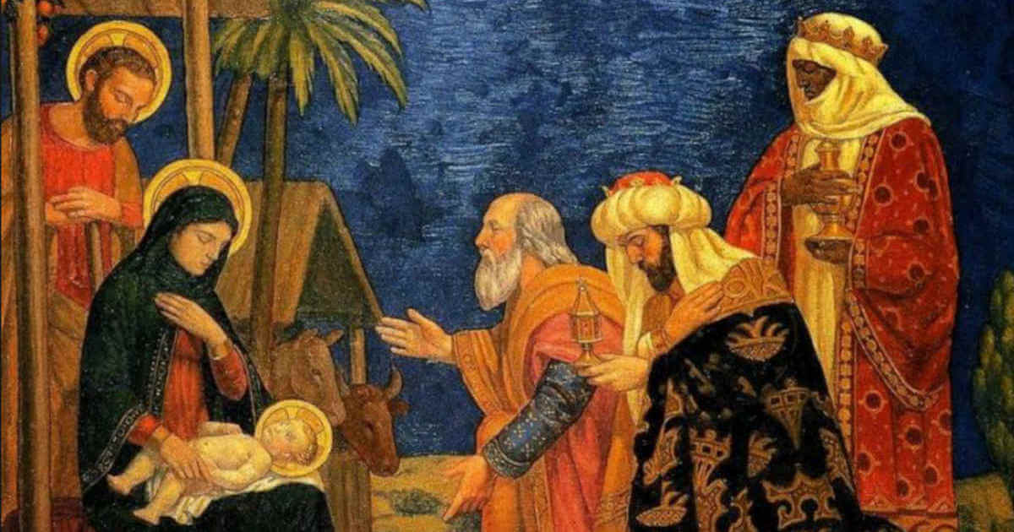
The Epiphany of the Lord
Matthew 2:1-12
https://www.youtube.com/watch?v=OJao9nq-Ss4

Slide 2
Gospel:
After Jesus had been born at Bethlehem in Judaea during the reign of King Herod, some wise men came to Jerusalem from the east. ‘Where is the infant king of the Jews?’ they asked. ‘We saw his star as it rose and have come to do him homage.’ When King Herod heard this he was perturbed, and so was the whole of Jerusalem. He called together all the chief priests and the scribes of the people, and enquired of them where the Christ was to be born. ‘At Bethlehem in Judaea,’ they told him ‘for this is what the prophet wrote:
‘And you, Bethlehem, in the land of Judah,
you are by no means least among the leaders of Judah,
for out of you will come a leader
who will shepherd my people Israel.’
Then Herod summoned the wise men to see him privately. He asked them the exact date on which the star had appeared, and sent them on to Bethlehem. ‘Go and find out all about the child,’ he said ‘and when you have found him, let me know, so that I too may go and do him homage.’ Having listened to what the king had to say, they set out. And there in front of them was the star they had seen rising; it went forward, and halted over the place where the child was. The sight of the star filled them with delight, and going into the house they saw the child with his mother Mary, and falling to their knees they did him homage. Then, opening their treasures, they offered him gifts of gold and frankincense and myrrh. But they were warned in a dream not to go back to Herod, and returned to their own country by a different way.
Matthew 2:1-12

Slide 3
Gospel Reflection:
The feast of the Epiphany invites us to see ourselves in the Magi – a people on a journey to Christ. They possess the humility and the openness of mind and heart to seek and welcome Jesus. Their following of the star is a journey of faith, a constant search for meaning, for purpose, for the things of God. They were not put off on that journey, even as they encountered people and events along the way that had the potential to keep them from achieving their goal. Their search mirrors our own search for kindness, compassion, justice, peace and forgiveness. This is the message at the heart of the Epiphany celebration.
St Paul writes, "You will shine like stars in the sky”
The light of the Epiphany is given to us as a gift, but we cannot keep it to or for ourselves. Through how we behave in our daily lives and how we treat each other, we are called to make our families, homes, parish communities and the wider world a better and brighter place for all people, especially the poor and the marginalised.

Slide 4


We do not always have a star to follow, to show us that we are following what God wants us to do.
God has given us Jesus, to show us how we should try to live our lives.
Post-it Challenge:
How do we follow God in our lives?
How will you follow God in the coming week?

Slide 5
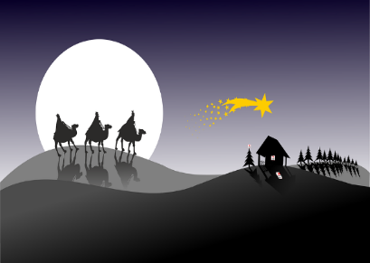
‘…they saw the child with his mother Mary…’
Post-it Challenge:
Imagine you are one of the wise men.
How would you have felt seeing Jesus in the stable?

Slide 6

What are your hopes and dreams for 2022?
Let us Pray:
Lord, inspire and guide us in our hopes and dreams.
We pray for our schools, our families and our friends: that we may always be open to following God in thoughts, actions and words.
We pray for the Church throughout the world, that it may shine like the star, leading people to Jesus, and spread God’s message of justice, peace and love.
May the Light of Christ fill all our homes, parishes and communities this day and always.
Amen.

