Slide 1
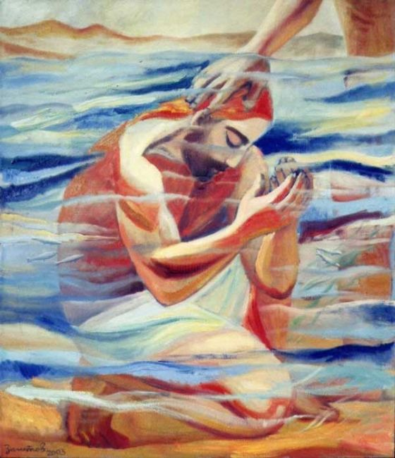
Gospel
The Feast of the Baptism of the Lord (Year C)
’Luke 3:15-16,21-22
https://www.youtube.com/watch?v=CoxopsRSfdU

Slide 2
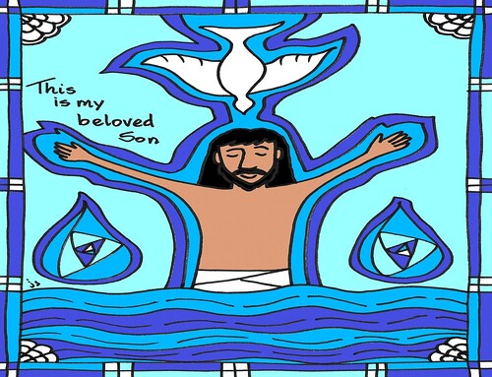
A Reading from the Holy Gospel according to Luke
A feeling of expectancy had grown among the people, who were beginning to think that John might be the Christ, so John declared before them all, ‘I baptise you with water, but someone is coming, someone who is more powerful than I am, and I am not fit to undo the strap of his sandals; he will baptise you with the Holy Spirit and fire. Now when all the people had been baptised and while Jesus after his own baptism was at prayer, heaven opened and the Holy Spirit descended on him in bodily shape, like a dove. And a voice came from heaven, ‘You are my Son, the Beloved; my favour rests on you. ’Luke 3:15-16,21-22
The Gospel of the Lord,
Praise to you Lord Jesus Christ.

Slide 3
Gospel Reflection
This week’s gospel marks the end of the Christmas season and by baptising Jesus in the River Jordan, John announces the arrival of Jesus as the Messiah, the Son of God. The Baptism of Jesus acts as a bridge between the Old Testament prophets, of which John the Baptist was the last, and the New Testament life of Jesus, full of grace and truth. With the Baptism of Jesus, communication between God and humankind is restored. As a child of God, He is pleased with you too. His favour rests on you also. There are times when we don’t feel that we are good enough. John felt that he was not good enough to untie the strap of Jesus’ sandal and certainly not good enough to baptise Jesus, however, he had a crucial role to play in helping people to understand who Jesus really is and so do we!
‘We ask ourselves, who am I to be brilliant, talented, gorgeous and fabulous?
Actually…who are you not to be? You are a child of God.’ (M. Williamson)

Slide 4
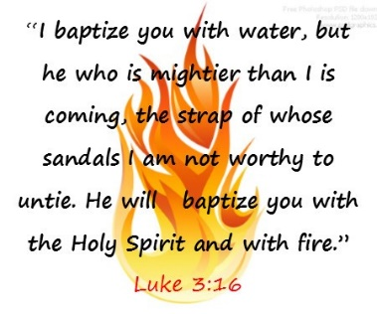
Post-it challenge:
We can communicate with God through Prayer
Close your eyes and reflect on your day, just for a moment…Your challenge today is to find the positives around you – from your parents, your teachers, your friends.
Ask God if there is anything he wants you to do for him. Ask the Holy Spirit to help you. How will others know that the Holy Spirit working through you in this coming week?
Try to see God in others.

Slide 5
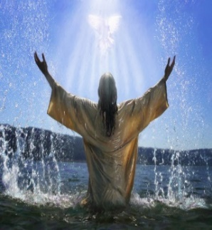
With the Baptism of Jesus, communication between God and humankind is restored. As a child of God, He is pleased with you too.
We can communicate with God through prayer.
Close your eyes and reflect on your day, just for a moment - Your challenge today is to find the positives around you – from your parents, your teachers, your friends. Try to see God in others.
Use the link below to find music for your reflection.
‘You are my Son, the Beloved; my favour rests on you.’
https://www.youtube.com/watch?v=CoxopsRSfdU

Slide 6

Affirmation
If we can affirm those around us and make them feel good about themselves then we are sharing God’s love.
In your class take a name or names of those around you and write down something good about that person or a few kind words about that person. Share these thought with each other.
In this way you are being messengers of God’s love.
‘Love one another as I have loved you’
1 Corinthians

Slide 7
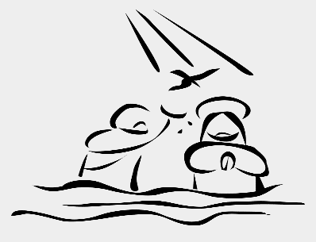
Let us Pray:
Lord, fill us with your Holy Spirit let me always look for the positives in my life each day and find ways to show kindness towards others.
~
Help me to make time in my day to reflect on my attitude and my way of being so that how I treat others in my thoughts, my words and my actions allows God’s love for me shine out to all around me.
Amen
https://www.youtube.com/watch?v=CoxopsRSfdU

