Slide 1
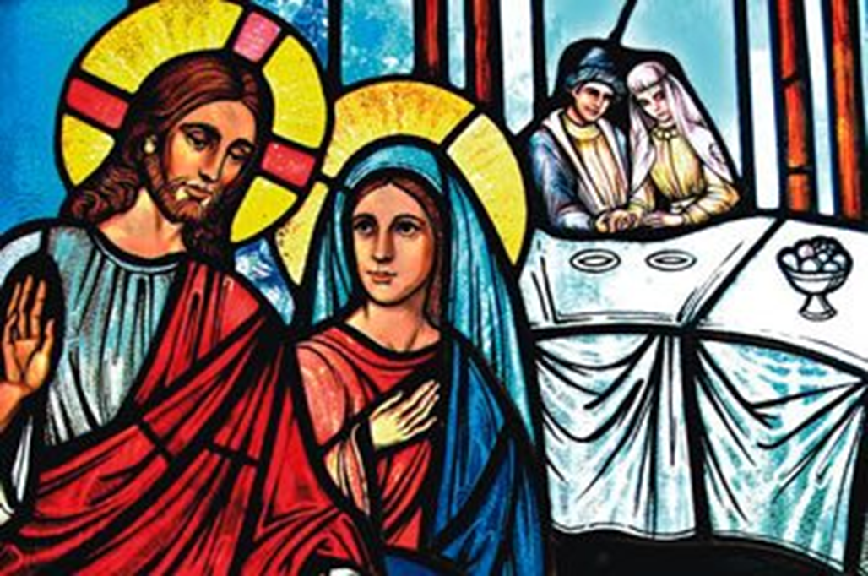
The 2nd Sunday of Ordinary Time
John 2:1-11
Year C
https://www.youtube.com/watch?v=l9GsKFIaRo0

Slide 2

A Reading from the Holy Gospel According to John
There was a wedding at Cana in Galilee…
When they ran out of wine, since the wine provided for the wedding was all finished, Mary said to Jesus, ‘They have no wine.’
Jesus said ‘Woman, why turn to me? My hour has not come yet.’
His mother said to the servants, ‘Do whatever he tells you.’
There were six stone water jars standing there … Jesus said to the servants, ‘Fill the jars with water’, and they filled them to the brim.
They did this; the steward tasted the water, and it had turned into wine.
The Gospel of the Lord,
Praise to you Lord Jesus Christ.

Slide 3
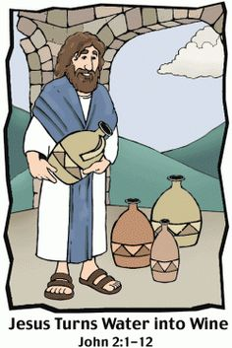
Reflection:
Today's Gospel tells about a time when Mary and Jesus were guests at a wedding feast and how Mary asked Jesus to help the bride and groom in a moment of need when they ran out of wine at the party. Turning the water into wine is the first miracle that Jesus performs. Although Jesus replied to Mary saying, My hour has not come yet,’ Mary trusted Jesus and knew that he would listen to her and bring joy to the celebration with His response.
In this Gospel, we learn to follow Mary's example when we ask for God’s help for those in need. We know that we can be confident that God will answer our prayers in extraordinary ways, although not always in ways that we might expect.

Slide 4

Post-it Challenge:
Jesus not only made things better for all those at the wedding feast, He shows us that God will respond to our needs and to the needs of our world in ways beyond our imagining. He shows us that nothing is impossible for him.
Where might we see people in need in our lives today?
Remember …
God works through all of us …
You are his helpers!
How might we respond to make these situations better?

Slide 5
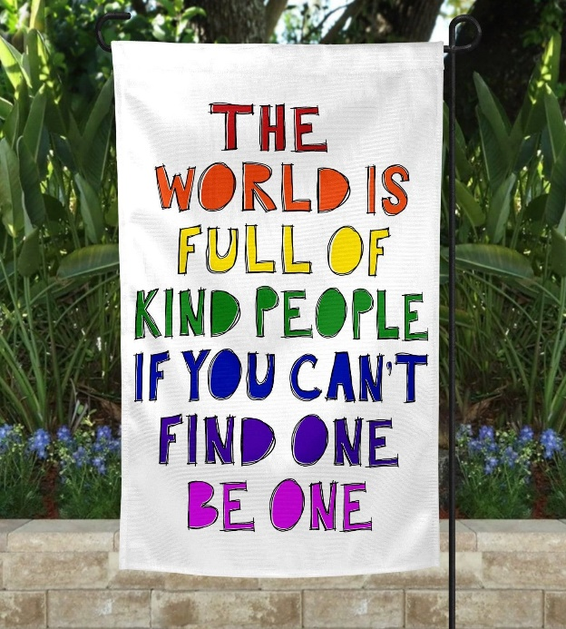
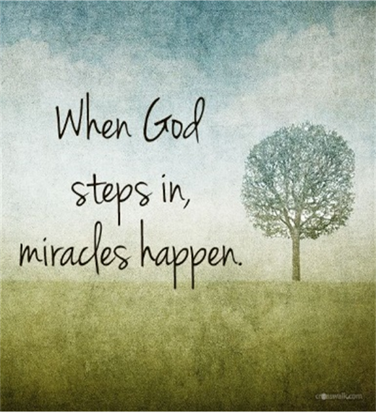
Let us pray:
God of wonder, we know that all things are possible for you. Let us open our eyes to the everyday miracles of the people around us and let us be that miracle for others. Amen

