Slide 1
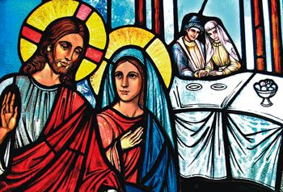
Gospel
2nd Sunday of Ordinary Time C
John 2:1-11
https://www.youtube.com/watch?v=4ZRwn_Thg2Q&list=RD4ZRwn_Thg2Q&start_radio=1

Slide 2
A Reading from the Holy Gospel according to John
There was a wedding at Cana in Galilee. The mother of Jesus was there, and Jesus and his disciples had also been invited. When they ran out of wine, since the wine provided for the wedding was all finished, the mother of Jesus said to him, ‘They have no wine.’ Jesus said ‘Woman, why turn to me? My hour has not come yet.’ His mother said to the servants, ‘Do whatever he tells you.’ There were six stone water jars standing there, each could hold twenty or thirty gallons. Jesus said to the servants, ‘Fill the jars with water’, and they filled them to the brim. ‘Draw some out now’ he told them ‘and take it to the steward.’ They did this; the steward tasted the water, and it had turned into wine. Having no idea where it came from – only the servants who had drawn the water knew – the steward called the bridegroom and said, ‘People generally serve the best wine first, and keep the cheaper sort till the guests have had plenty to drink; but you have kept the best wine till now.’ John 2:1-11
The Gospel of the Lord,
Praise to you Lord Jesus Christ.

Slide 3
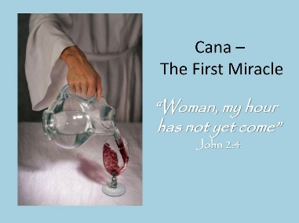
Gospel Reflection
Today's Gospel tells about a time when Mary and Jesus were guests at a wedding feast and how Mary asked Jesus to help the bride and groom in a moment of need when they ran out of wine at the party. Turning the water into wine is the first miracle that Jesus performs. Although Jesus replied to Mary saying, My hour has not come yet,’ Mary trusted Jesus and knew that he would listen to her and bring joy to the celebration with His response.
In this Gospel, we learn to follow Mary's example when we ask for God’s help for those in need. We know that we can be confident that God will answer our prayers in extraordinary ways, although not always in ways that we might expect.

Slide 4
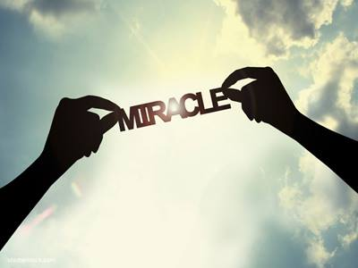
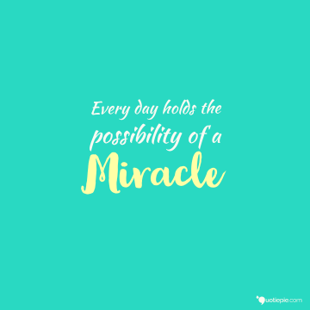
Post-it challenge:
Mary brought the need she saw to Jesus because she believed that Jesus could make the situation better.
Jesus not only made things better for all those at the wedding feast, He also used this as an opportunity to show us that God will respond to our needs and to the needs of our world in ways beyond our imagining. He shows us that nothing is impossible for him.
What situations of need do we see in our lives today?
How might God respond to make these situations better?

Slide 5
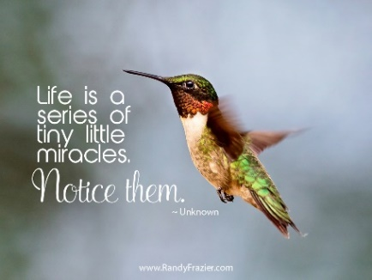
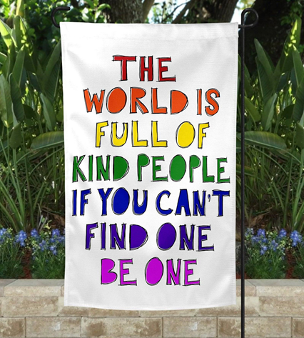
Do you believe in miracles?
When we do not know how something happens, and we know that it can only have been done by God, we call it a miracle.
Have you ever witnessed a miracle in your life?
Miracles can be the small things in everyday life which make a big difference to those around you.
Discuss.
While we cannot work miracles, we can make real changes that make a difference to our own lives or the lives of others.
Post-it challenge: What changes will you make today?

Slide 6
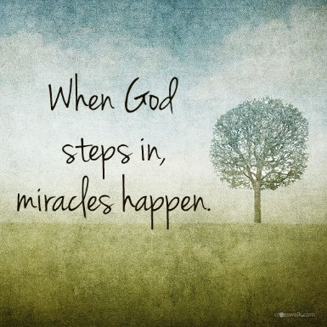
Let us Pray
God of wonder, we know that all things are possible for you.
Encourage us to respond the needs of each other and to make changes in our lives to make the world a better place.
Let us open our eyes to the everyday miracles of the people around us and let us be that miracle for others. Amen

