Slide 1

Gospel
3r^{d} Sunday of Ordinary Time C
Luke 1:1-4; 4:14-21
Rend Collective - Rescuer (Good News) [Official Music Video] - YouTube

Slide 2
Gospel 3rd Sunday of Ordinary Time Year C With the power of the Spirit in him, Jesus stood up to read and they handed him the scroll of the prophet Isaiah. Unrolling the scroll, he found the place where it is written: the Spirit of the Lord has been given to me, for he has anointed me. He has sent me to bring the good news to the poor, to proclaim liberty to captives and to the blind new sight, to set the downtrodden free, to proclaim the Lord’s year of favour. He then rolled up the scroll and sat down. And all eyes in the synagogue were fixed on him. Then he began to speak to them, ‘This text is being fulfilled today even as you listen.
The Gospel of the Lord,
Praise to you Lord Jesus Christ.

Slide 3

Gospel Reflection -
In the gospel this week we hear about Jesus teaching in the Synagogue. Jesus has been sent by God to save the world. The words he spoke were very important.
…the Spirit of the Lord has been given to me, for he has anointed me. He has sent me to bring the good news to the poor, to proclaim liberty to captives and to the blind new sight, to set the downtrodden free, to proclaim the Lord’s year of favour.
These words were written about Jesus but the people listening did not realise this until Jesus explained that He had come to be that person.
The Holy Spirit (God’s Spirit)would help him with this work
The Holy Spirit is Jesus' gift to the Church. The Holy Spirit allows the Church to carry on the mission of Jesus.
When we do what Jesus did ~ show love, respect and kindness towards each other ~ then we are serving the Kingdom of God.

Slide 4


“Jesus was sent to bring the Good News, to enter the hearts of each one of us.”
Pope Francis
Post-it Challenge:
How does Jesus describe the Good News that God sent him to bring to the world?
How can you be the ‘Good News’ to those around you?

Slide 5
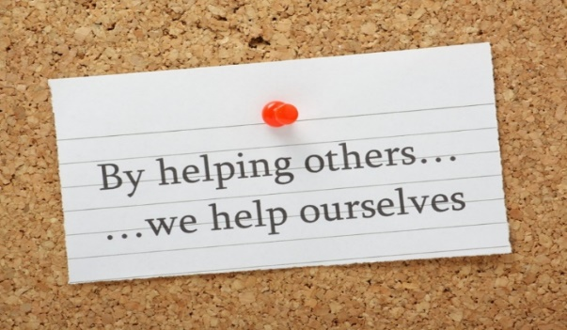
Dear God,
You call each one of us to tell your Good News to people who are poor, hungry, sad, lonely, bullied, scared, or weary.
May we do all that we can to answer that call. Amen.
Let us pray:

