Slide 1
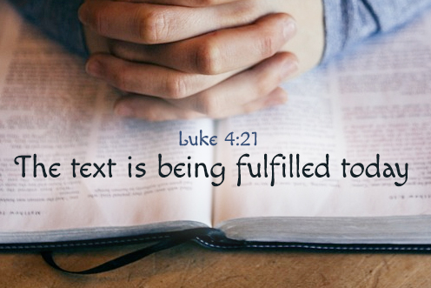
Gospel
3r^{d} Sunday of Ordinary Time C
https://www.youtube.com/watch?v=eSTfM8M2Md8
Luke 1:1-4; 4:14-21
Rend Collective - Rescuer (Good News) [Official Music Video] - YouTube

Slide 2
Gospel 3rd Sunday of Ordinary Time Year C Jesus, with the power of the Spirit in him, returned to Galilee; and his reputation spread throughout the countryside. He taught in their synagogues and everyone praised him. He came to Nazara, where he had been brought up, and went into the synagogue on the sabbath day as he usually did. He stood up to read and they handed him the scroll of the prophet Isaiah. Unrolling the scroll, he found the place where it is written: the Spirit of the Lord has been given to me, for he has anointed me. He has sent me to bring the good news to the poor, to proclaim liberty to captives and to the blind new sight, to set the downtrodden free, to proclaim the Lord’s year of favour. He then rolled up the scroll and sat down. And all eyes in the synagogue were fixed on him. Then he began to speak to them, ‘This text is being fulfilled today even as you listen.
The Gospel of the Lord,
Praise to you Lord Jesus Christ.

Slide 3

Gospel Reflection -
In the gospel this week we hear about Jesus teaching in the Synagogue. Jesus has been sent by God to bring salvation to the world. To save the world. Jesus announces His mission by reading from the words of Isaiah,
…the Spirit of the Lord has been given to me, for he has anointed me. He has sent me to bring the good news to the poor, to proclaim liberty to captives and to the blind new sight, to set the downtrodden free, to proclaim the Lord’s year of favour.
These words were written about Jesus but the people listening did not realise this until Jesus explained that He had come to be that person and that with the help of the Holy Spirit he will now fulfil the words of Scripture.
The Holy Spirit is Jesus' gift to the Church. The Holy Spirit enables the Church to continue the mission of Jesus. When we do what Jesus did—show love, respect and kindness towards each other—we serve the Kingdom of God.

Slide 4


“Jesus was sent to bring the Good News, to enter the hearts of each one of us.”
Pope Francis
How does Jesus describe the vision of the world that God promised?
How can you be the ‘Good News’ to those around you?

Slide 5

Post-it challenge:
“He has sent me to bring the good news to the poor”
The Gospel tells us that Jesus has come to bring good news to people who are poor.
What do you think this means?
Does it just mean that a person has no money or is living below the poverty line?
How many different ways might a person be poor? Think about poor in Spirit.
Discuss.
How can I make a difference?

Slide 6
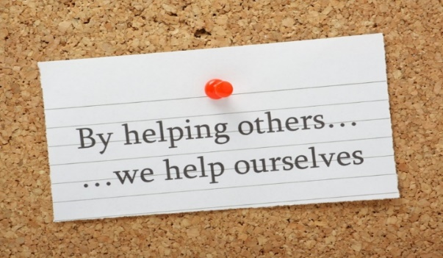
Let us pray:
Dear God,
You call each one of us to proclaim your Good News to people who are poor, hungry, sad, lonely, bullied, scared, or weary.
May we do all that we can to answer that call.
We ask this through Christ our Lord,
Amen.

