Slide 1
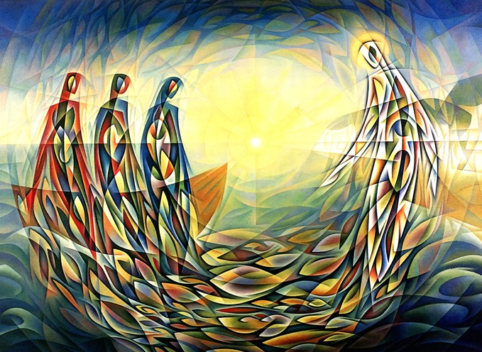
Gospel: 5th Sunday of Ordinary Time - Year C
https://www.youtube.com/watch?v=qv-SXz_exKE&list=RD4ZRwn_Thg2Q&index=16

Slide 2
Gospel - 5th Sunday of Ordinary Time - Year C Jesus was standing one day by the Lake of Gennesaret, with the crowd pressing round him listening to the word of God, when he caught sight of two boats close to the bank. The fishermen had gone out of them and were washing their nets. He got into one of the boats – it was Simon’s – and asked him to put out a little from the shore. Then he sat down and taught the crowds from the boat. When he had finished speaking he said to Simon, ‘Put out into deep water and pay out your nets for a catch.’ ‘Master,’ Simon replied, ‘we worked hard all night long and caught nothing, but if you say so, I will pay out the nets.’ And when they had done this they netted such a huge number of fish that their nets began to tear, so they signalled to their companions in the other boat to come and help them; when these came, they filled the two boats to sinking point. When Simon saw this he fell at the knees of Jesus saying, ‘Leave me, Lord; I am a sinful man.’ For he and all his companions were completely overcome by the catch they had made; so also were James and John, sons of Zebedee, who were Simon’s partners. But Jesus said to Simon, ‘Do not be afraid; from now on you will be fishers of men.’ Then, bringing their boats back to land, they left everything and followed him. Lk5:1-11 The Gospel of the Lord Praise to you Lord Jesus Christ

Slide 3
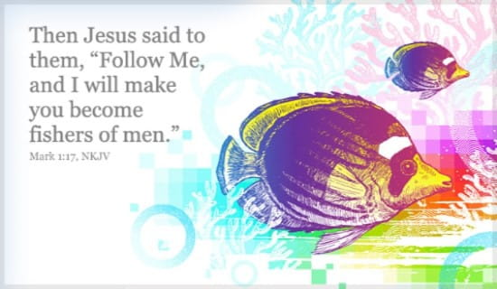
Reflection: Have you ever had a life-changing experience where you look back and say, "That changed my life!"? In today’s Gospel we hear how this is exactly what happened to Simon when Jesus stepped into his boat and everything changed.
Many people around the world still make their living from catching fish today. Simon was a good fisherman who had a positive, life-changing experience based on something not going right – he caught no fish! Jesus also tells us to “put out into deep water” – to move in a new, sometimes frightening, directions. The message might come to us from our parents, our teachers or from a book, a television program, a news flash. Sometimes Jesus speaks to us through a negative experience. Good things will come from bad experiences when Jesus is in your boat.
In the Gospel, good came because Simon did what the Lord asked him to do, even though he did not want to do it. In fact, it was inconvenient! God’s challenges for us may also be inconvenient, although as Simon discovered, God would never ask us to do anything that would hurt us. Simon struggled to see the bigger picture outside of his world as a fisherman but when he listened to God everything changed. He did not just make his best catch of fish ever, but he became a leader among the disciples and of the future Church.

Slide 4

Post-it Challenge:
When Jesus steps into our boat, everything will change.
How will you know that Jesus has stepped into your boat?
How will your life be changed?
What do you find challenging about the idea of change?

Slide 5
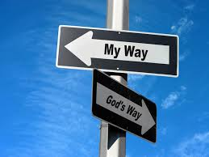
Follow Jesus who is the source of freedom and light. Be open to the Lord so that He may lighten all your ways.”
Pope John Paul II
Jesus didn't talk down to people.
When you talk to people, get in their boat, be on their
wavelength.
Use words they understand. Speak to them with kindness
And compassion.
Write down one positive difference you can make
to someone else today?

Slide 6
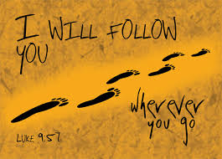
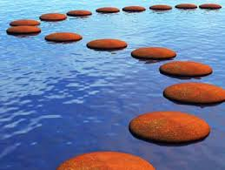
How can we follow Jesus in our lives today?

Slide 7

Let us pray
Let us be silent in our prayer today.
Let us listen to the words of our parents and our teachers.
Let us listen to God, speaking to us through them. Amen
Amazing things will happen!

