Slide 1
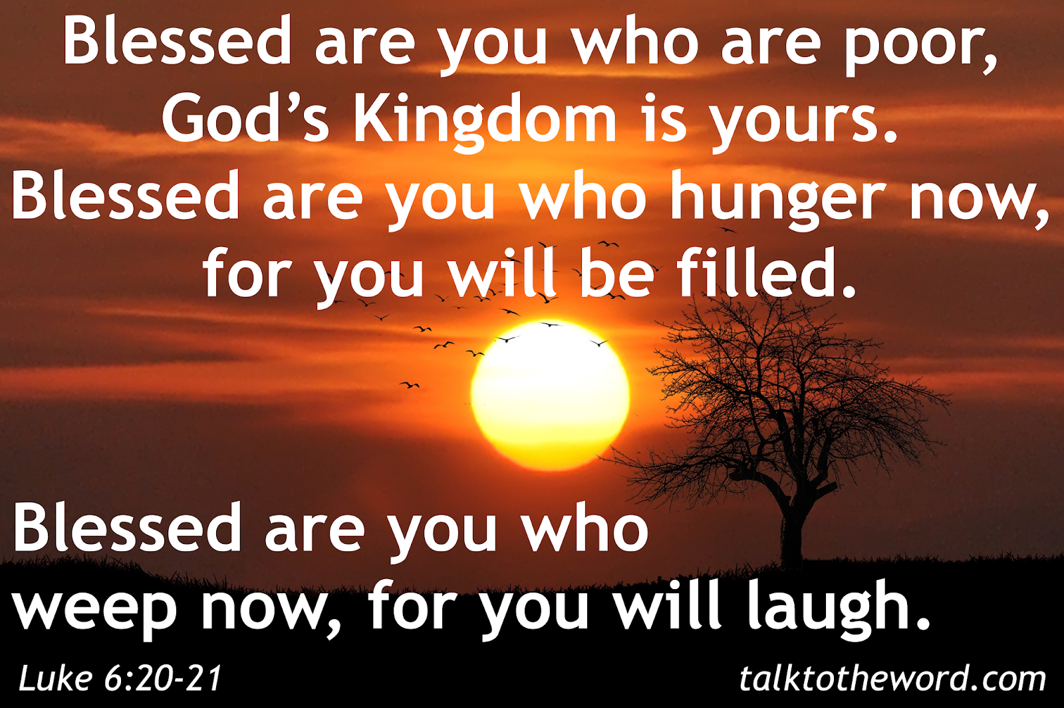
Gospel: 6th Sunday of Ordinary Time
Year C
https://www.youtube.com/watch?v=VIMh6lS6VjE

Slide 2

Gospel - 6th Sunday of Ordinary Time - Year C Jesus looked up at his disciples and said: ‘Blessed are you who are poor, for yours is the kingdom of God. ‘Blessed are you who are hungry now, for you will be filled. ‘Blessed are you who weep now, for you will laugh. ‘Blessed are you when people hate you, and when they exclude you, revile you, and defame you on account of the Son of Man. Rejoice on that day and leap for joy, for surely your reward is great in heaven; for that is what their ancestors did to the prophets. ‘But woe to you who are rich, for you have received your consolation. ‘Woe to you who are full now, for you will be hungry. ‘Woe to you who are laughing now, for you will mourn and weep. ‘Woe to you when all speak well of you, for that is what their ancestors did to the false prophets. Luke 6:17,20-26
The Gospel of the Lord,
Praise to you Lord Jesus Christ.

Slide 3

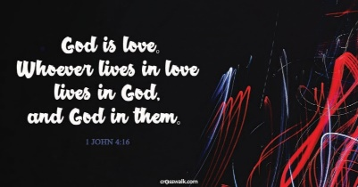
Reflection:
In the Gospel message this week, Jesus teaches His apostles and the crowd the way to happiness. This piece of Scripture is known as the Beatitudes. A beatitude is a blessing – and more than that. Someone who is “blessed” is more than happy.
The blessed are filled with God’s joy. Jesus wants all people to be happy. Even if you are not healthy, famous, beautiful, rich, strong or brilliant, the beatitudes are His promise of happiness. They make it seem like the best thing ever to be poor, sad or disadvantaged. He gives a guarantee that He will be our happiness here on earth and in heaven.
Cont…

Slide 4
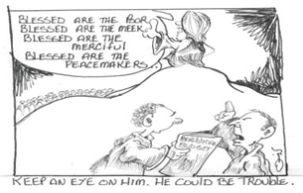
We are challenged by the beatitudes to trust completely in God, to simplify our lives and to change the notion of what society values. The reality that Jesus teaches in today's Gospel is that things are not always as they appear. The Beatitudes turn upside down the values of the world. The world sets up the rich to be first; Jesus puts the poor on top of the world. The world tells us to seek happiness at all costs; Jesus offers us another set of values to make us happy.
We know that God is love. His love is completely unconditional. We don’t have to earn it and there is nothing we can do to stop God loving us. We call this love ‘Agape’. Agape is unconditional love; it is willing good for the other. The Beatitudes tell us that if we want to be happy, we must desire to be like God. Do it and you’ll be happy.
Pope Francis described the Beatitudes as the roadmap for Christian life which gives us the ability to move forward on the right path.

Slide 5
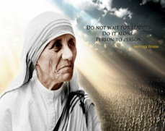
Post-it challenge:
How might people be "poor”?
(Clue: not related to economic class.)
One way in which I am ‘poor’ is …
How can we show other people that we want the best for them?
Let no-one ever come to you, Lord, without leaving better and happier.”
St. Teresa of Calcutta.

Slide 6

Let us pray:
Lord, help me to get my priorities right in the small everyday things,
to share what I have with others,
to defend those who are excluded by my classmates,
to hug someone who is crying,
to give my time to someone who is lonely,
to forgive those who offend me …
and most of all be prepared to offer a smile and a kind word to everyone I meet today.
I ask this in Jesus name. Amen

