Slide 1

Gospel: 8th Sunday of Ordinary Time
Year C
https://www.youtube.com/watch?v=pRviefdwJi4

Slide 2
Gospel - 8th Sunday of Ordinary Time - Year C
A good man brings good things out of the good stored up in his heart, and an evil man brings evil things out of the evil stored up in his heart. For the mouth speaks what the heart is full of. Adapted from Luke 6:39-45
The Gospel of the Lord,
Praise to you Lord Jesus Christ.

Slide 3


Reflection:
Jesus teaches us that in order to do good deeds and be of service to others, we must have a good heart.
If we cannot be good and do what is right, how can we ask other people to do the same?
We must pay attention to our own poor choices as we cannot help others when we are blind to our own faults.
Jesus says that good people have a store of goodness in their hearts; that the words someone speaks come from what is in their heart. So, if we let God fill our hearts with goodness and love, we will be able to speak words
which will share the goodness and love with others.

Slide 4



Post-it Challenge:
Do you allow the right kind of light to shine from your heart?
Talk to your teacher about what these quotes mean to you.
Are you the person that Jesus asks you to be – Is your heart full of goodness?
How might you persuade yourself to change to become a great role model in your class?

Slide 5
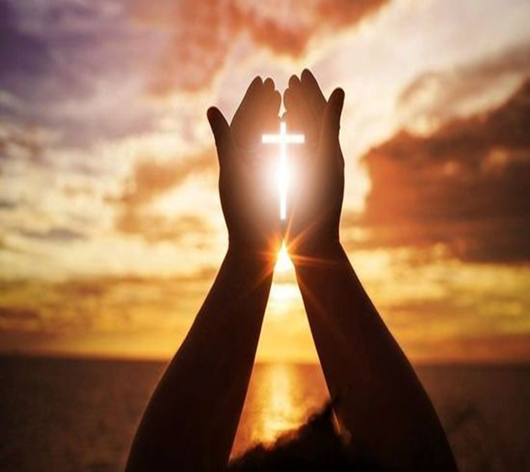

Let us pray:
Loving God,
Fill our hearts with kindness, love, and generosity.
Help us to be the people you created us to be.
Amen

