Slide 1
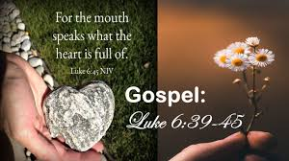
Gospel: 8th Sunday of Ordinary Time
Year C
https://www.youtube.com/watch?v=P-Zp586pvZg

Slide 2
Gospel - 8th Sunday of Ordinary Time - Year C
Jesus told them this parable: “Can the blind lead the blind? Will they not both fall into a pit? The student is not above the teacher, but everyone who is fully trained will be like their teacher “Why do you look at the speck of sawdust in your friend’s eye and pay no attention to the plank in your own eye? How can you say to your friend, ‘Friend, let me take the speck out of your eye,’ when you yourself fail to see the plank in your own eye? You hypocrite, first take the plank out of your eye, and then you will see clearly to remove the speck from your friend’s eye. “No good tree bears bad fruit, nor does a bad tree bear good fruit. Each tree is recognized by its own fruit. People do not pick figs from thorn bushes, or grapes from briers. A good man brings good things out of the good stored up in his heart, and an evil man brings evil things out of the evil stored up in his heart. For the mouth speaks what the heart is full of. Luke 6:39-45
The Gospel of the Lord,
Praise to you Lord Jesus Christ.

Slide 3
Reflection:
Jesus talks about seeing a tiny splinter in someone else’s eye, but not seeing the great plank of wood in our own.
We are the “blind leading the blind” if we try to help or influence others when we aren’t willing to examine our conscience and change our own behaviour. Jesus is saying it is much easier to notice the tiniest mistake that someone else has made, rather than to see our own mistakes and what we have done wrong.
He teaches us that in order to do good deeds and be of service to others, we must have integrity and a good heart. He is saying we must change the way we act before we can expect anyone else to change. If we cannot be good and do what is right, how can we ask other people to do the same?
So this week the Gospel teaches us to pay attention to our own poor choices rather than focus all our attention on someone else’s; that we cannot help others when we are blind to our own faults.
Jesus says that good people have a store of goodness in their hearts; that the words someone speaks come from what is in their heart. So, if we let God fill our hearts with goodness and love, we will be able to speak words
which will share the goodness and love with others.

Slide 4


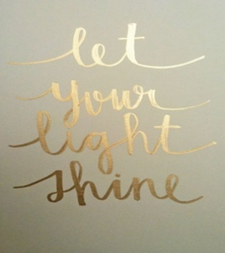
Post-it Challenge:
There is a saying: ‘When we point our finger at others, we have three fingers pointing back at ourselves.’
We don’t notice the three fingers because they’re hidden. The saying warns us about making judgments about others. When we judge others, we are not noticing the behaviours we need to change in ourselves.
Do you allow the right kind of light to shine from your heart?
Write a sentence to explain what these quotes mean to you.
Are you the person that Jesus asks you to be or are you the blind leading the blind?
How might you persuade yourself to change to become a great role model in your school?

Slide 5

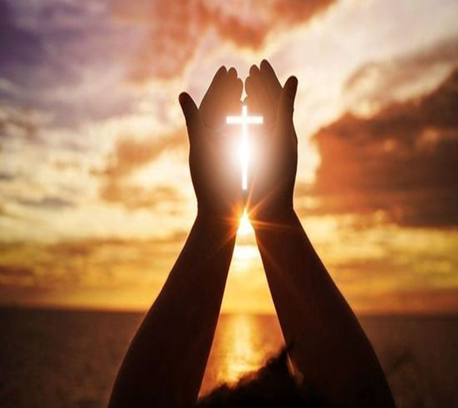
Let us pray:
Loving God,
Fill our hearts with kindness, love, and generosity.
Guide us to be the people you created us to be.
Inspire us with hope, courage and goodness.
Help us to change ourselves first, before judging others, so that our world becomes a better place for everyone we meet. Amen

