Slide 1

Gospel: 1st Sunday of Lent ~Year C
A reading from the Holy Gospel according to Luke

Slide 2

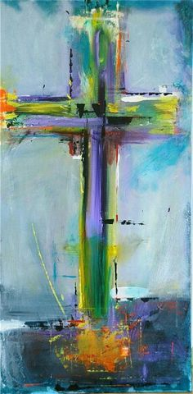
A reading from the Holy Gospel according to Luke
The temptation in the wilderness
Filled with the Holy Spirit, Jesus left the Jordan and was led by the Spirit through the wilderness, being tempted there by the devil for forty days. During that time, he ate nothing and at the end he was hungry. The devil said to him, ‘If you are the Son of God, tell this stone to turn into a loaf.’ Jesus replied
‘Scripture says: Man does not live on bread alone.’
Then leading him to a height, the devil showed him in a moment of time all the kingdoms of the world and said to him, ‘I will give you all this power and the glory of these kingdoms, for it has been committed to me and I give it to anyone I choose. Worship me, then, and it shall all be yours.’ But Jesus answered him,
‘Scripture says, you must worship the Lord your God,
and serve him alone.

Slide 3


…Then he led him to Jerusalem and made him stand on the parapet
of the Temple.
‘If you are the Son of God,’ he said to him ‘throw yourself down from here,
for scripture says:
He will put his angels in charge of you
to guard you, and again:
They will hold you up on their hands
in case you hurt your foot against a stone.’
Jesus answered
‘It has been said: You must not put the
Lord your God to the test.’
Having exhausted all these ways of tempting him
the devil left him, to return at the appointed
time.

Slide 4
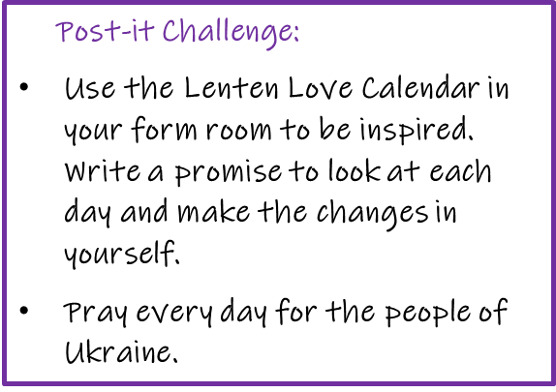

Reflection:
In the gospel we learn that Jesus spent 40 days and night in the desert in a time of praying, fasting and reflection. At the end of that time, when he was feeling weak with hunger and very vulnerable, the devil came to tempt him. In each of the temptations described, Jesus was faced with the choice of spending his time and energy on activities that would lead him away from God. To resist the temptation of doing the wrong thing, Jesus quoted words from Scripture showing how much he believed in God’s word.
One of the greatest temptations we face is to waste time. This temptation can lead us to neglect spending time and energy on important things, for example, sometimes we are tempted to devote more time to watching television than doing our homework or helping out at home.
During Lent we should turn away from ‘temptation’ or doing the wrong thing. We should make choices in our lives in a way that allows others to know about God’s love, as Jesus did.

Slide 5


Let us pray:
Our God,
Take us on a journey from where we are to where you want us to be,
So that we become a community where all are welcome and none are excluded,
All are valued and no-one is made to feel inadequate,
All are forgiven and no-one is ashamed to belong,
All are encouraged and no-one is too hurt to come among us.
We ask this in Jesus’ name , Amen
‘Lent is a powerful season, a turning point that can foster change in each of us. Let us deny ourselves something every day to help others.’ Pope Francis
https://www.youtube.com/watch?v=gS9e0nxHP-w

