Slide 1
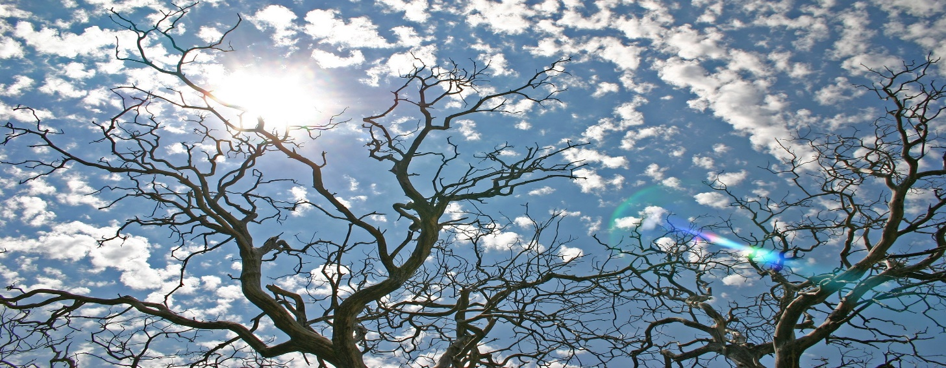
Gospel
3rd Sunday of Lent, Year C
The Parable of the Fig Tree
Luke 13:1-9
'Leave the fig tree one more year'

Slide 2
Gospel
'Leave the fig tree one more year'
Some people arrived and told Jesus about the Galileans whose blood Pilate had mingled with that of their sacrifices. At this he said to them, ‘Do you suppose these Galileans who suffered like that were greater sinners than any other Galileans? They were not, I tell you. No; but unless you repent you will all perish as they did. Or those eighteen on whom the tower at Siloam fell and killed them? Do you suppose that they were more guilty than all the other people living in Jerusalem? They were not, I tell you. No; but unless you repent you will all perish as they did.
He told this parable: ‘A man had a fig tree planted in his vineyard, and he came looking for fruit on it but found none. He said to the man who looked after the vineyard, “Look here, for three years now I have been coming to look for fruit on this fig tree and finding none. Cut it down: why should it be taking up the ground?” “Sir,” the man replied “leave it one more year and give me time to dig round it and manure it: it may bear fruit next year; if not, then you can cut it down.”’ Luke 13:1-9
https://www.youtube.com/watch?v=nCWtEvK4JEE&safe=true

Slide 3
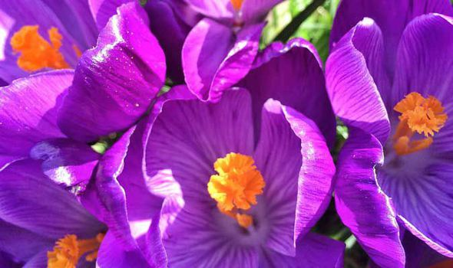

Reflection
The parable Jesus tells in this Gospel is about a fig tree. The man had been waiting for three years for the tree to give him some fruit. He was angry and disappointed that this had not happened. He asked his gardener to cut down the tree.
The gardener did not want to give up on the tree. He had a greater plan and did not give up on the tree. He gave the fig tree another chance and provided all the things it needed to live. He watered and fed the tree and he did it with patience, loyalty and love.
God is like the gardener - He is always hopeful that we will ask for his forgiveness. God doesn't give up on us. Instead, He continually watches over us, helping us to become the people that he intends for us to be.
During Lent, we try to remember that God helps us, reaching out to us with patience and hopefulness that we will return to him in faith and love.

Slide 4
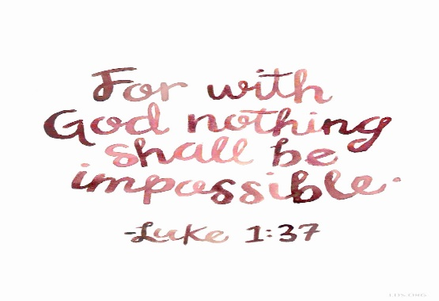
How resilient are you?
How often do we give up on things in our lives – relationships, subjects, friends –do we walk away when things get difficult? Could we be more patient, more loving, more hopeful?
Post-it challenge:
What can I change in my life to make me
more like the gardener – more resilient,
more patient and more kind?
What is God trying to do in our lives?
Do we ever take the time to be still and just listen?

Slide 5

Let us pray,
Lord, we thank you for our school,
Helps us to grow together as a strong, faith-filled community.
We ask that you give us the humility to share our strengths and gifts and the determination, resilience and open-mindedness to listen to others when we are struggling.
We thank you for our families and our friendships.
Most of all we ask that you continue to teach us and lead us, in being the people you would like us to be, as you walk beside us every day of our lives. Amen

