Slide 1
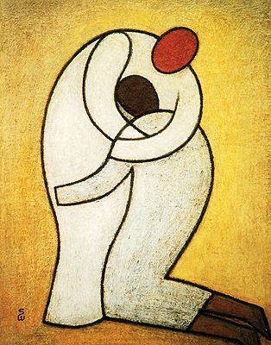
Gospel
4th Sunday of Lent (Laetare Sunday)
The Parable of the Lost Son
Luke 15:11-32
https://www.youtube.com/watch?v=itiB52mVJ9Y

Slide 2
A Reading from the Holy Gospel according to Luke
‘I am no longer worthy to be called your son’
Jesus said: “There was a man who had two sons. The younger one said to his father, ‘Father, I want my share of your estate now, before you die.’ So his father agreed to divide his wealth between his sons.
“A few days later, the younger son packed all his belongings and moved to a distant land and wasted his money in wild living. About the time his money ran out, a great famine swept over the whole country, and he began to starve. He persuaded a local farmer to hire him and was sent to his fields to feed the pigs. The young man was so hungry that even the food the pigs were eating looked good to him. But no one gave him anything to eat. “When he finally came to his senses, he said, ‘At home even the hired servants have food to spare, and here I am dying of hunger! I will go home and say to my father: Father, I have sinned against heaven and against you. I am no longer worthy to be called your son; please take me on as one of your hired servants.’ So he got up and went to his father. “But while he was still a long way off, his father saw him coming. Filled with love and compassion for him, he ran to his son, threw his arms around him and kissed him. Cont…

Slide 3
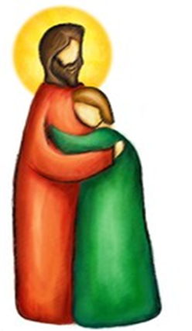
Cont…
“The son said to him, ‘Father, I have sinned against heaven and against you. I am no longer worthy to be called your son.’
But the father said to his servants, ‘Quick! Bring the finest robe in the house and put it on him. Put a ring on his finger and sandals on his feet. Kill the calf we have been fattening and kill it. Let’s have a feast and celebrate. For this son of mine was dead and is alive again; he was lost and is found.’ So they began to celebrate. Meanwhile, the older son was in the field. When he came near the house, he heard music and dancing. So he called one of the servants and asked him what was going on. ‘Your brother is back,’ he replied, ‘and your father has killed the fattened calf. We are celebrating because of his safe return.’
The older brother became angry and refused to go in. So his father went out and pleaded with him. But he answered his father, ‘Look! All these years I’ve been slaving for you and never once refused to do a single thing you told me. Yet you never even gave me a young goat for a feast with my friends. But when this son of yours who has squandered your money returns, you celebrate by killing the fattened calf for him!’
‘My son,’ the father said, ‘you are always with me, and everything I have is yours. But we had to celebrate and be glad, because this brother of yours was dead and is alive again; he was lost and is found.’

Slide 4
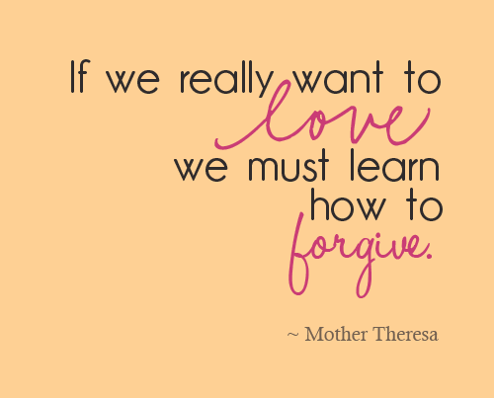

The Fourth Sunday of Lent is traditionally called Laetare Sunday. Laetare is a Latin word that means “rejoice.” Today's Gospel describes the reason for our joy: God's great love for us has been revealed in Jesus. Through his Passion, Death, and Resurrection, Christ has reconciled us with God and one another.
This Gospel invites us to consider the depth of God's mercy and love.
Can you imagine asking your parents to forgive you for something you did wrong and hearing that a party was going to be given in your honour instead? The father in the parable is an image for us of how much God wants to forgive us. If ever we feel we have done something so bad that God could never forgive us, we can remember this story. During Lent, we say we're sorry for our sins and ask God to forgive us.
Is it easy to say ‘sorry’ when you have made the wrong choice?
How does it feel when you say ‘ sorry’ and the other person says ‘it’s ok’?
How do you show you are sorry … how do you put those small words into action?

Slide 5
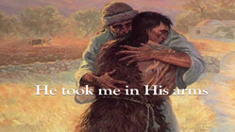
Post-it Challenge:
Who is right?
When the younger son says he wants his inheritance, he is saying to his father he is ready to live as if his father is no longer alive, that he is dead to him. This is what happens when we sin; we say we want to live like God doesn’t exist – like the whole world is just about us and not anyone else.
The older son is jealous of the attention his brother gets. He gets angry with his father because his father seems to treat him less well than he treats his brother, even though he has made good choices throughout his life and his brother hasn’t.
Have you ever felt like this?
Why is this wrong in God’s eyes?
Which brother do you most identify with? Why?
Both are as sinful as each other – Why?

Slide 6

Act of Sorrow
O my God because you are so good,
I am truly sorry that I have sinned against
you and with your grace,
I will try not to sin again. Amen

