Slide 1


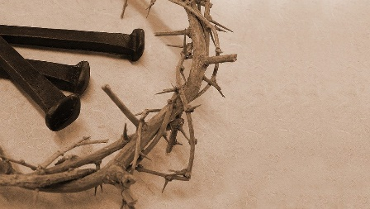
The Servant King

Slide 2
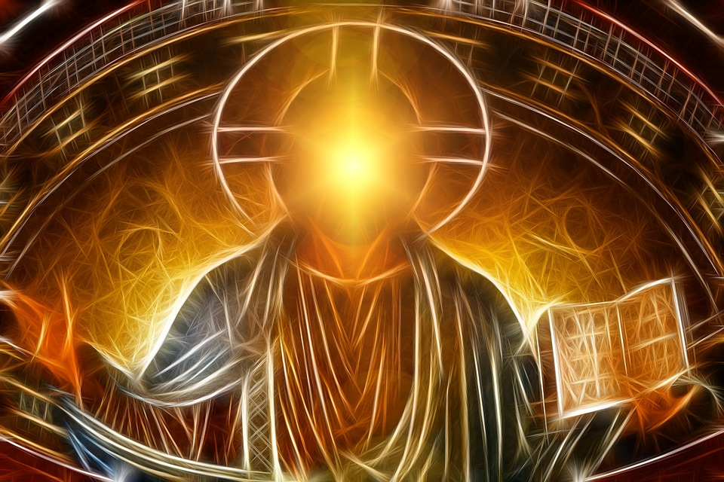
Jesus came to establish an eternal kingdom which is founded on love and gives peace, freedom, and fullness of life.
Pope Francis 2020
Christ the King

Slide 3
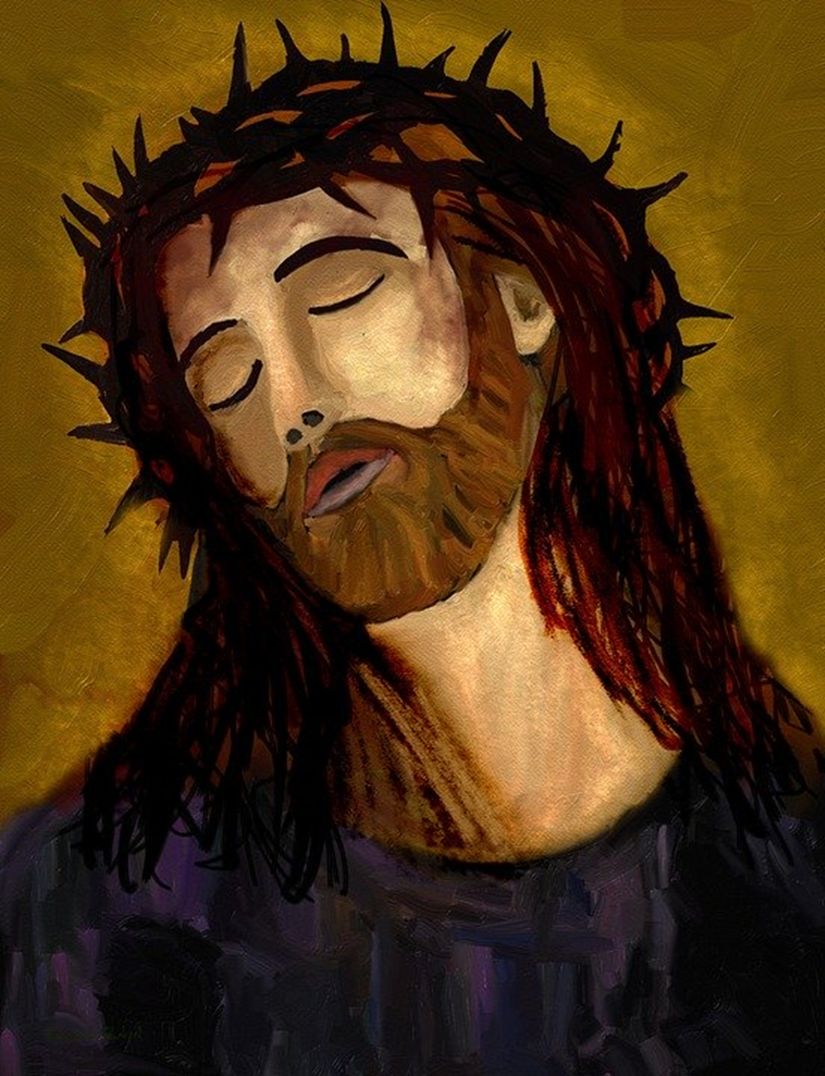
Christ the King Sunday celebrates Christ as King and Lord of the universe.
This Feast Day is celebrated on the final Sunday of Ordinary Time, the final Sunday before Advent begins. This year it falls on 22nd November.
On this solemnity the priest wears white and the readings are the same each year. Can you identify any of them in these slides?

Slide 4

At Baptism, we are anointed with holy oil as priest, prophet and king.
The feast of Christ the King is a time when we can reflect on our own kingship, on what being a ‘king’ means and how to be one.
Understanding the feast helps to make our own call better.

Slide 5
Jesus taught us to pray the Our Father. During this prayer we say:
‘Our Father who art in heaven… thy kingdom come, thy will be done on earth as it is in heaven’.
This means that we are praying for a world of peace, justice, equality and love, just as Jesus showed us.
Let us pray together the Our Father, thinking in particular of these words and asking for God’s help in building his kingdom.
Ki Our Father…

Slide 6
Jesus is a king. What kind of king is he?
How does he help his people?
Ki Before we begin…

Slide 7
‘As for you, my sheep, I will judge between sheep and sheep, between rams and he-goats’ (Ezek: 34)
Jesus is a good king; he looks over us like a caring shepherd, making sure that we are safe and protecting us from harm unlike other dominant rulers. He knows everything about us, there is nothing we can hide.
T

Slide 8

T How can you prepare to meet Christ?

Slide 9
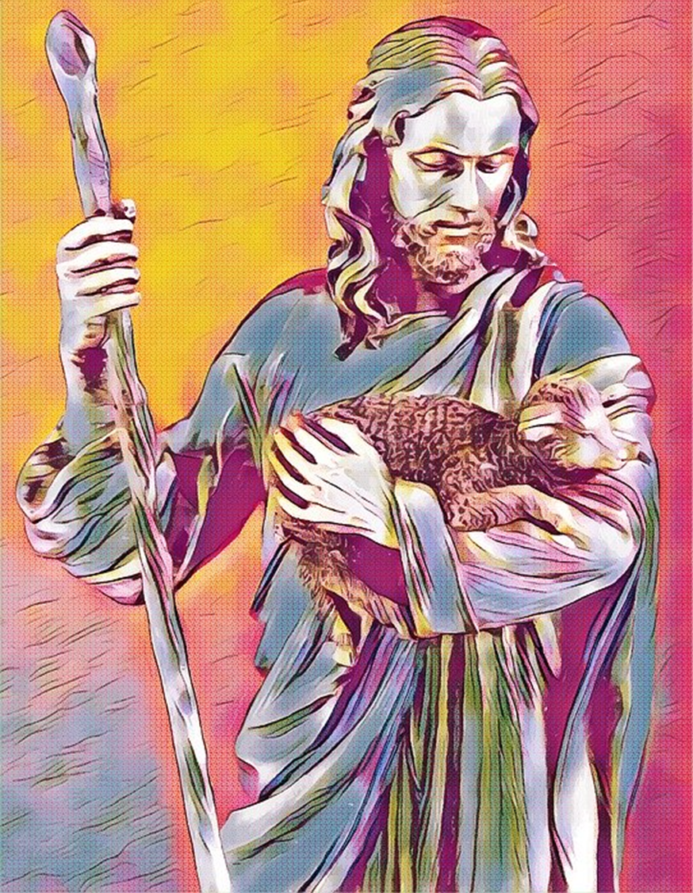
‘The Lord is my shepherd, there is nothing I shall want’ (Ps: 22)
Jesus is a descendant of King David who was the shepherd boy who defeated Goliath. David was also a skilled musician who wrote many of the psalms including this one. David had a great love of God and trusted him deeply. Jesus invites us to do the same.
M

Slide 10
Although times can be difficult and we are given many challenges to overcome, Jesus teaches us that God will give us everything we need. Christ our king will protect us from all spiritual harm.
M How can Christ protect you?

Slide 11
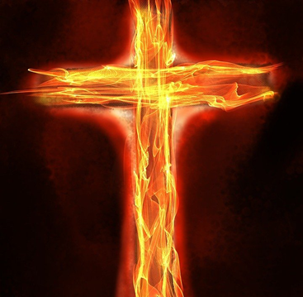
‘Just as all men die in Adam, so all men will be brought to life in Christ’ (1 Cor 15)
In Genesis, Adam sits in state and God brings all of the animals for him to give him names. To give names to their subjects is the ‘act’ of a king. The ‘responsibility’ of a king is then to care for his subjects, which why we have been entrusted by God to look after the world and all of creation.
.
MH

Slide 12
Jesus takes this responsibility even further. He, who is King of the Universe, is both the ruler and servant of all. His crown was not one of jewels, but of thorns. He rules in triumph and he rules from the cross.
MHow are you responsible like a king?

Slide 13
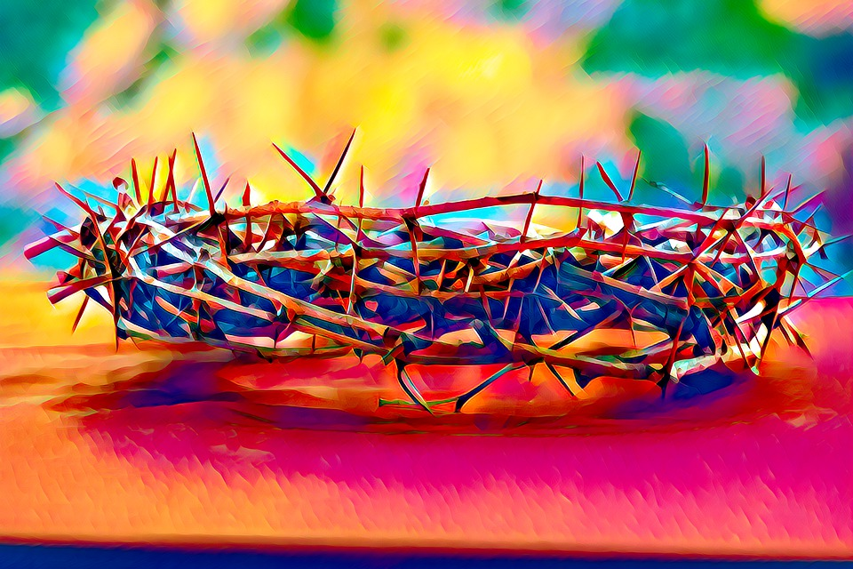

Slide 14
‘Then the King will say to those on his right hand, “Come, you whom my Father has blessed, take for your heritage the kingdom prepared for you since the foundation of the world. For I was hungry and you gave me food…’ (Mt: 25)
Jesus tells us that when we look after those in need and show love to others, we are doing the same to him.
Christ our king challenges us to see him in others, especially those who are rejected and despised by others. He is the king of love, our servant king.
MHow can you be a ‘servant king’?

Slide 15
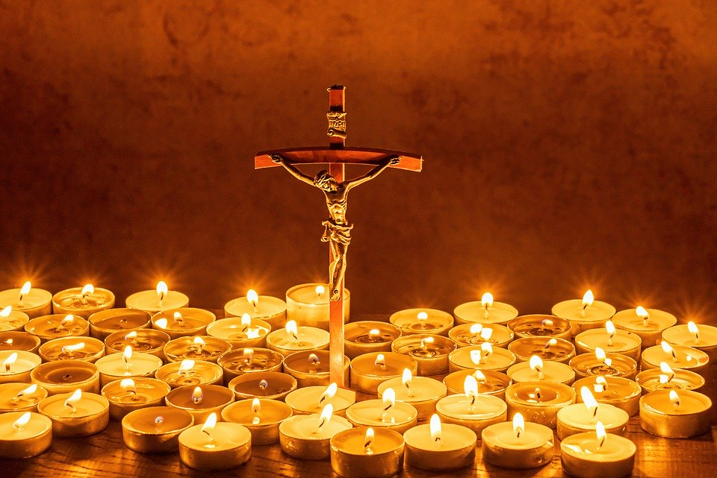
Let us pray

Slide 16
We pray to Christ our king:
For all our rulers and leaders…
For those in need…
For those suffering injustice and inequality…
For the vulnerable…
For those who are ill or grieving …
For our own intentions…
Glory be…
Let us pray

Slide 17

Christ be beside me
Christ be before me
Christ be behind me
King of my heart
Christ be within me
Christ be below me
Christ be above me
Never to part.
Prayer from St Patrick’s Breastplate

Slide 18
Who am I called to serve today?
How can I build up God’s Kingdom at home/school?
Mission

Slide 19
King of Everything

