Slide 1
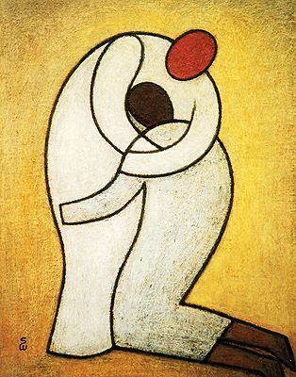
Gospel
4th Sunday of Lent (Laetare Sunday)
The Parable of the Lost Son
Luke 15:11-32
https://www.youtube.com/watch?v=itiB52mVJ9Y

Slide 2
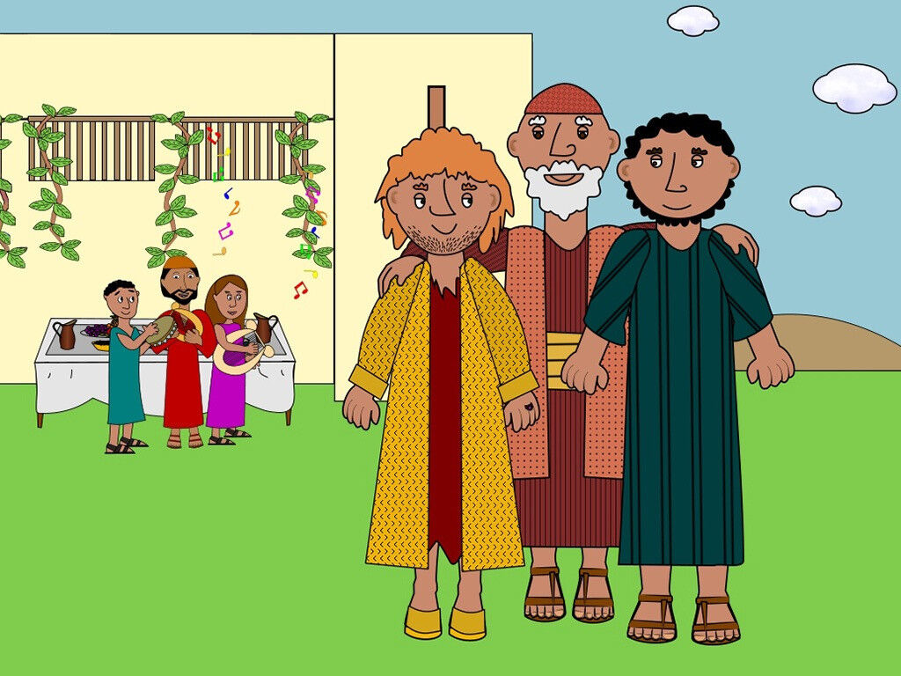
A Story from Saint Luke
Today’s Gospel is about a loving Father and his two sons.
Watch the video to learn what a very important message from Jesus about love and forgiveness.
https://www.bedtimeshortstories.com/prodigal-son-story

Slide 3
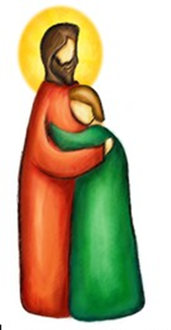

Reflection
The Fourth Sunday of Lent is traditionally called Laetare Sunday. Laetare is a Latin word that means “rejoice.” Today's Gospel describes the reason for our joy: it tells us of God's great love for us and how God loves all of his children and always forgives.
Post-it Challenge
Is it easy to say ‘sorry’ when you have made the wrong choice?
How does it feel when you say ‘ sorry’ and the other person says ‘it’s ok’?
How do you show you are sorry … how do you put those small words into action?

Slide 4


Slide 5

Let us Pray:
Dear God our Father, who lives in heaven, there is power in your name.
We trust your ways…from your kingdom in heaven all the way down to earth where we live.
Please provide all we need today.
Forgive our mistakes as we forgive those who make mistakes against us.
Help us to make good choices and protect us from all that is evil.
Everything we have and do is all for you, so everyone we meet will see you in us.
Forever and ever, amen.
https://www.youtube.com/watch?v=OJao9nq-Ss4

